Slide 1
HPO campaign — final report
Winning with data: High-Performing Organizations · 17 Aug – 20 Oct 2026

Slide 2
The short version
331 sign-ups in total: 155 report downloads, 117 ad lead-form sign-ups, 59 breakfast registrations
Paid spend 44 175 SEK — 378 SEK per ad sign-up (LinkedIn 679 SEK, Meta 82 SEK)
Email carried the launch: 59% of the first 122 downloads came from the HPO email blasts
Meta Norway was the cheapest paid channel by far — best ad Guide HIPO | C at 90 SEK
LinkedIn: the ROW '7 things' list GIF brought 44 of 58 sign-ups at 251 SEK each; SE/NO GIFs brought 1 each
Next launch: email + organic first, Meta for volume, LinkedIn for reach in the right companies

Slide 3
Results at a glance
PAID SPEND
REPORT DOWNLOADS (WEB)
AD LEAD-FORM SIGN-UPS
44 175 SEK
155
117
LinkedIn 39 360 · Meta 4 814
SE 107 · NO 33 · EN 15
LinkedIn 58 · Meta 59
BREAKFAST REGISTRATIONS
COST PER PAID SIGN-UP
TOTAL SIGN-UPS
59
378 SEK
331
Stockholm, 30 Sep
LinkedIn 679 SEK · Meta 82 SEK
downloads + lead forms + event
Source: LinkedIn Ads API, Meta Marketing API, HubSpot forms · 17 Aug – 20 Oct 2026

Slide 4
Downloads week by week
The launch carried it
Most downloads came in the first two weeks, when the email blasts went out (26 Aug) and the report was new.
After that, the flow is a trickle that tracks the paid pushes: Meta Norway from 25 Sep and the LinkedIn refresh on 14 Oct.
Source: HubSpot report-download forms (SE/NO/EN), weeks starting Monday · 17 Aug – 20 Oct 2026

Slide 5
Where the downloads came from
Email did the heavy lifting
59% of the first 122 downloads came from the HPO email blasts and nurtures.
Organic social (our own and employee posts) was second. Paid social drove 13 — ads mostly fed lead forms instead.
Source: HubSpot, first 122 downloads (19 Aug – 17 Sep), by latest traffic source — as reported in the September CPR

Slide 6
Where the money went
Channel · market · format | Spend (SEK) | Impressions | Clicks | Sign-ups | Cost / sign-up
LinkedIn ROW · GIF | 18 809 | 97 003 | 386 | 52 | 362 SEK
LinkedIn SE · GIF | 5 855 | 13 723 | 43 | 1 | 5 855 SEK
Meta NO · Lead ads | 4 814 | 28 273 | 549 | 59 | 82 SEK
LinkedIn NO · GIF | 4 046 | 3 659 | 10 | 1 | 4 046 SEK
LinkedIn ROW · Document | 3 302 | 28 541 | 47 | 2 | 1 651 SEK
LinkedIn DK · Document | 2 250 | 19 387 | 40 | 1 | 2 250 SEK
LinkedIn SE · Carousel | 1 670 | 1 710 | 9 | 1 | 1 670 SEK
LinkedIn SE · Document | 1 648 | 917 | 3 | 0 | —
LinkedIn NO · Document | 1 632 | 543 | 3 | 0 | —
LinkedIn ROW · Carousel | 87 | 527 | 0 | 0 | —
LinkedIn DK · GIF | 59 | 664 | 2 | 0 | —
Total paid | 44 175 | 194 947 | 1 092 | 117 | 378 SEK
Source: LinkedIn Ads API, Meta Marketing API, HubSpot forms · 17 Aug – 20 Oct 2026

Slide 7
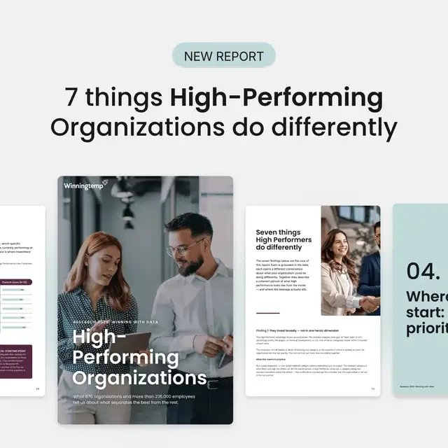
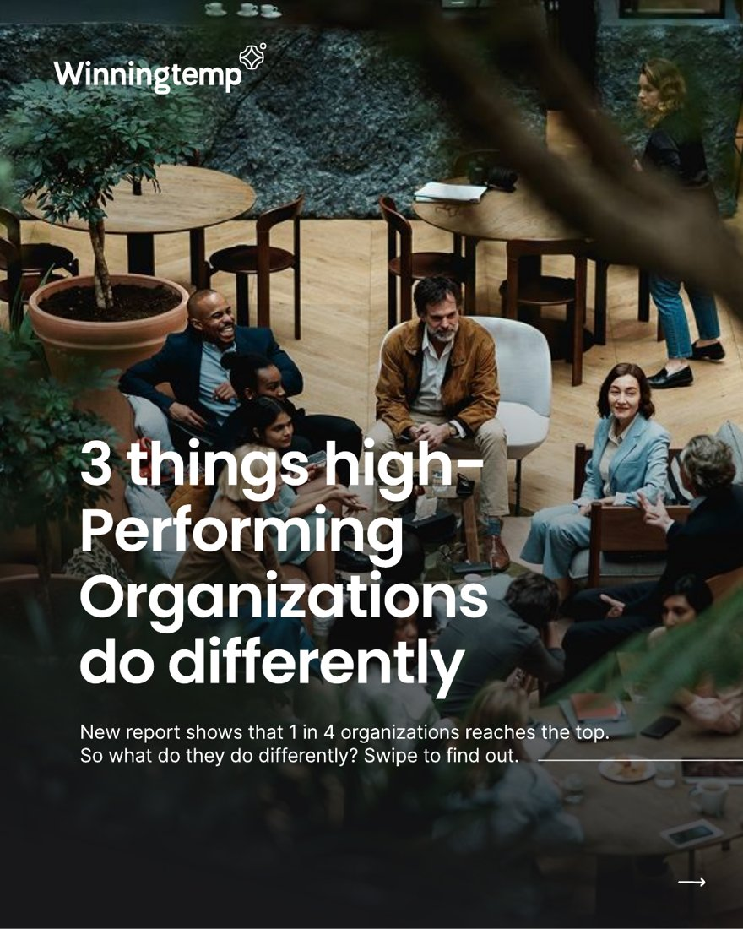

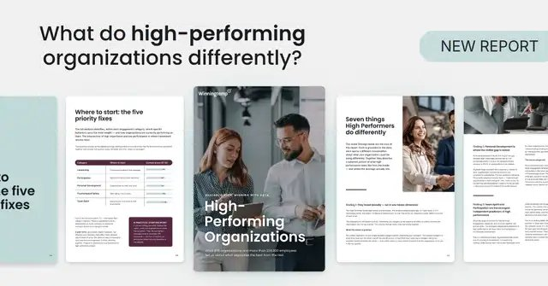
LinkedIn: the creatives that brought sign-ups
ROW · GIF · '7 things' list
ROW · GIF · question headline
ROW · Document ad · 3 tips PDF
ROW · GIF · institutional trust
44 sign-ups
4 sign-ups
2 sign-ups
2 sign-ups
11 032 SEK · 251 SEK/sign-up
231 clicks · 44 928 impr.
3 211 SEK · 803 SEK/sign-up
68 clicks · 19 996 impr.
3 302 SEK · 1 651 SEK/sign-up
47 clicks · 28 541 impr.
1 247 SEK · 624 SEK/sign-up
25 clicks · 10 044 impr.
Source: LinkedIn Ads API, creative level, HiPO campaigns · 17 Aug – 20 Oct 2026

Slide 8


LinkedIn: where the spend didn't convert
DK · Document ad · 3 tips PDF
SE · GIF · institutional trust
SE · Carousel · 3 tips
SE · Document ad · 3 tips PDF
1 sign-up
0 sign-ups
1 sign-up
0 sign-ups
2 250 SEK · 2 250 SEK/sign-up
40 clicks · 19 387 impr.
1 980 SEK
4 clicks · 987 impr.
1 670 SEK · 1 670 SEK/sign-up
9 clicks · 1 710 impr.
1 648 SEK
3 clicks · 917 impr.
Source: LinkedIn Ads API, creative level, HiPO campaigns · 17 Aug – 20 Oct 2026

Slide 9
LinkedIn: every creative concept compared
Concept | Markets | Ads | Spend (SEK) | Clicks | CTR | Sign-ups | Cost / sign-up
GIF · '7 things' list | NO ROW SE | 9 | 13 839 | 254 | 0.50% | 45 | 308 SEK
Document ad · 3 tips PDF | DK NO ROW SE | 4 | 8 832 | 93 | 0.19% | 3 | 2 944 SEK
GIF · question headline | NO ROW SE | 8 | 5 488 | 72 | 0.33% | 5 | 1 098 SEK
GIF · institutional trust | ROW SE | 3 | 3 232 | 29 | 0.26% | 2 | 1 616 SEK
Carousel · 3 tips | ROW SE | 2 | 1 758 | 9 | 0.40% | 1 | 1 758 SEK
GIF · generic | NO ROW SE | 7 | 1 695 | 13 | 0.25% | 0 | —
GIF · HR leadership | NO ROW SE | 9 | 1 610 | 22 | 0.27% | 1 | 1 610 SEK
GIF · 1 in 4 | ROW SE | 3 | 1 360 | 29 | 0.40% | 0 | —
Refresher GIFs (14 Oct) | ROW SE | 15 | 1 108 | 20 | 0.21% | 1 | 1 108 SEK
GIF · wrong investments | ROW SE | 3 | 437 | 2 | 0.15% | 0 | —
All HiPO creatives | All | 63 | 39 360 | 543 | 0.33% | 58 | 679 SEK
Source: LinkedIn Ads API, creative level, HiPO campaigns · 17 Aug – 20 Oct 2026 · concept read from the ad name

Slide 10
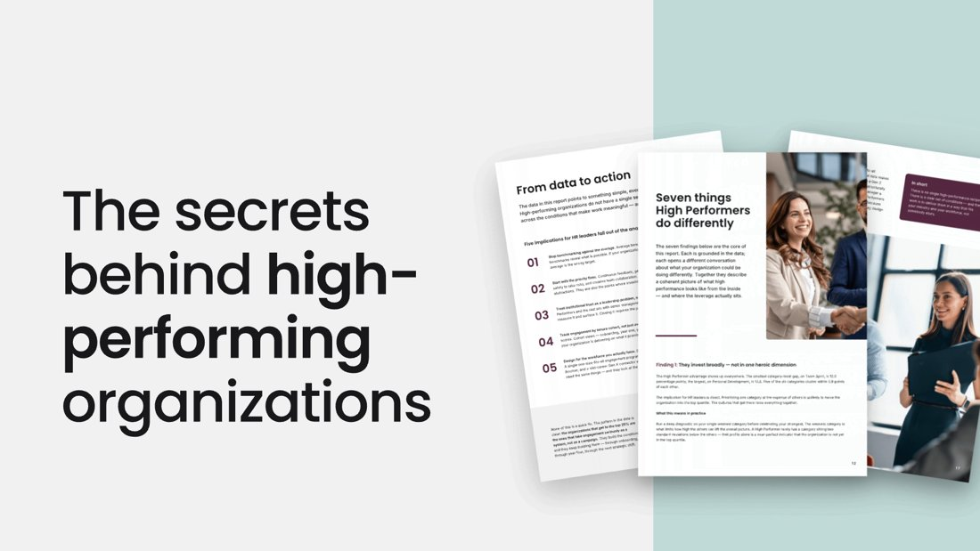

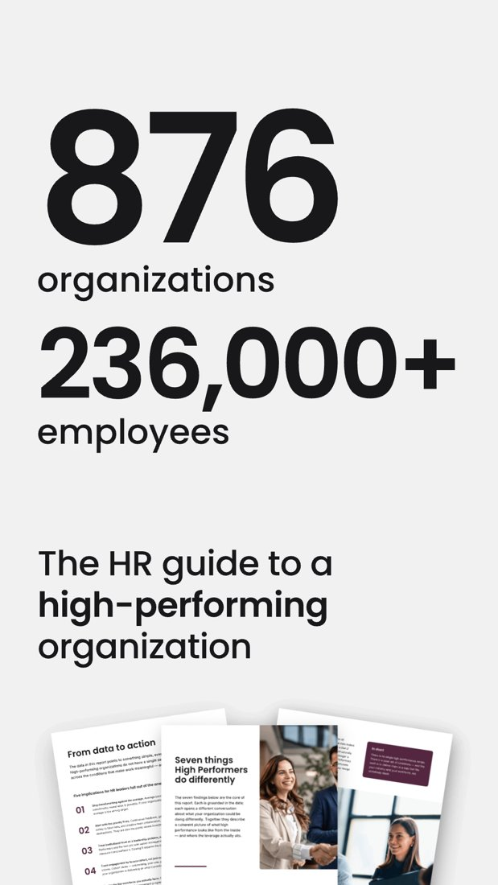
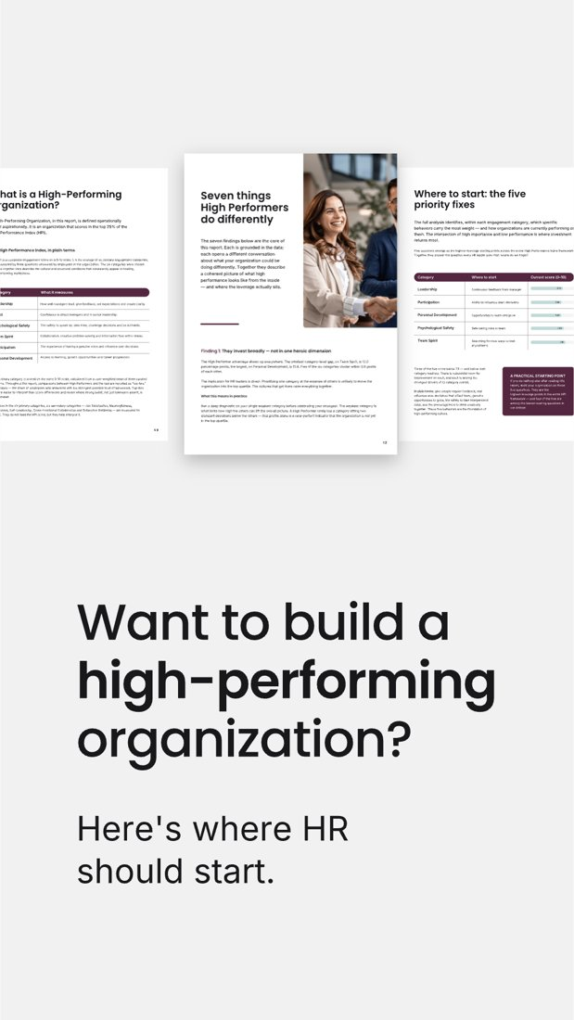
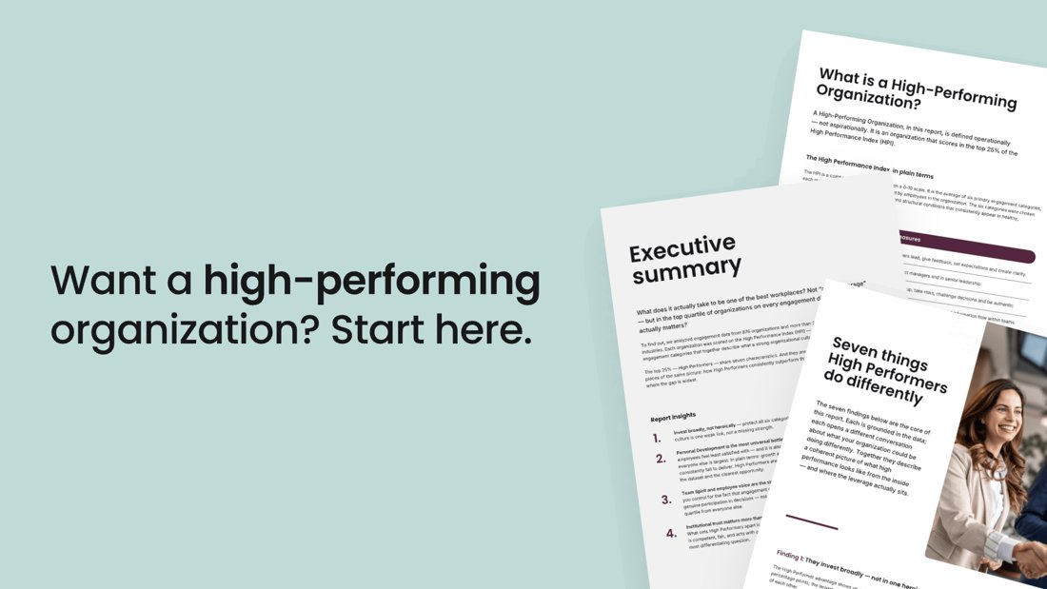
LinkedIn: the refresher creatives (14 Oct)
REFRESHER SPEND, 13–20 OCT
1 108 SEK
15 ads
CLICKS / IMPRESSIONS
20 / 9 653
New designs, 3 vertical + 2 horizontal (ROW versions shown).
Focus: a clear, concise message and offer.
Delivering in ROW (10 ads) and SE (5 ads); the NO versions show no delivery yet.
CTR 0.21%
SIGN-UPS SO FAR
1
One week in — too early to judge
Source: LinkedIn Ads API (creatives named NEW-…) · creative files from the 14 Oct refresh

Slide 11
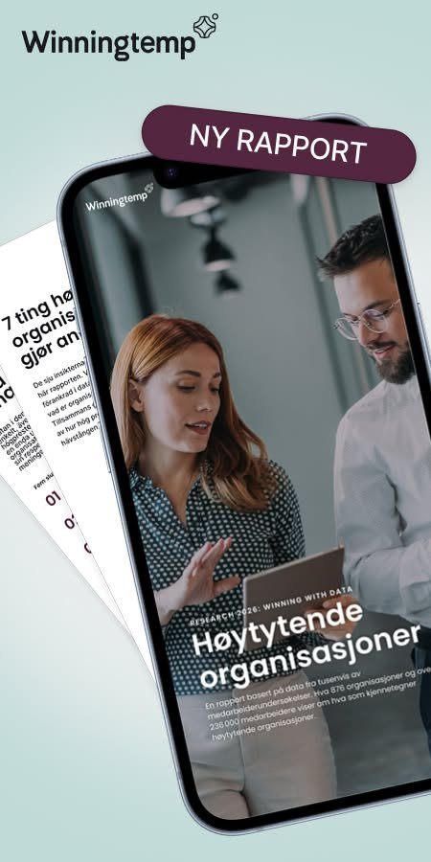
Meta: one image, five headlines (Norway)
Variant | Headline (translated from Norwegian) | Spend (SEK) | Clicks | Sign-ups | Cost / sign-up
C | “7 insights leaders should know” | 2 956 | 353 | 33 | 90 SEK
A | “What do high-performing organisations do differently?” | 1 690 | 189 | 26 | 65 SEK
A (2nd ad) | “What do high-performing organisations do differently?” | 49 | 1 | 0 | —
B | “The research behind high performance” | 44 | 1 | 0 | —
E | “What sets the best organisations apart” | 39 | 2 | 0 | —
D | “Get insight into what drives performance” | 37 | 3 | 0 | —
Total | All Guide HIPO ads | 4 814 | 549 | 59 | 82 SEK
One image, five headlines: Meta tested the copy only.
Meta put 97% of the budget behind C and A. The numbered '7 insights' headline won, the same angle as LinkedIn's best ad.
The image all variants used
Source: Meta Marketing API, ad level (leads = 'lead' actions only) · 17 Aug – 20 Oct 2026

Slide 12
What we learned
A gated report lives on its launch week — plan email, organic and paid to land together
Lead-form ads beat landing-page clicks for sign-ups; landing pages mostly converted email traffic
Small SE/NO LinkedIn audiences got expensive fast; the ROW set did the work
Creatives tire: the '7 things' GIF cost 80–170 SEK per sign-up in its first weeks, 230–390 SEK from mid-September
A numbered '7 …' promise won on both channels: LinkedIn's '7 things' GIF and Meta's '7 insights' headline
Meta in Norway delivered sign-ups at a fraction of LinkedIn's cost
Measure downloads as one number: web forms + LinkedIn + Meta lead forms

Slide 13
Next time
Launch day: email blast + LinkedIn posts from our people + paid on the same day
Budget Meta lead ads in every market from day one
Keep LinkedIn audiences broad enough (>50k) or use ROW-style targeting
Ship refresh creatives every 3 weeks; stop a creative when its cost per sign-up doubles
Follow up downloaders with a nurture that leads to a demo, and track it in HubSpot
Keep the report findable: Guides library entry (live 16 Oct) and blog posts

Slide 14
Thank you!

