Slide 1
CPR: LinkedIn Ads and digital visibility
Campaign Performance Review · 20 Aug – 16 Sep 2026

Slide 2
The short version
Four weeks since the last CPR — what changed
Sign-ups are up 30 Lead Gen sign-ups in the period (4 in the previous four weeks).
One campaign carries it TOFU 2 The high-performing organizations report in the ROW audience delivered 24 of the 30 sign-ups, at 509 SEK each.
Audience beats artwork The same report creative costs 184 SEK per sign-up in ROW and found almost nobody in SE and NO — the audiences were too small to deliver.
AI visibility in Sweden is climbing Videntic score 23 (well positioned), up from 5 in June. Winningtemp is the most-cited domain in Swedish AI answers.
Search is growing, site traffic is not Search Console clicks +73% and average position 38 → 15, while GA4 sessions are down 8% year to date.

Slide 3
LinkedIn Ads
01.

Slide 4
Account performance
20 Aug – 16 Sep 2026: budget doubled, sign-ups grew more than sevenfold
Spend
Impressions
Clicks
Lead Gen sign-ups
76 590 SEK
527 534
1 001
30
+113% vs previous 4 weeks
+122% vs previous 4 weeks
+50% vs previous 4 weeks
4 in previous 4 weeks
CTR
CPM
Cost per click
Website conversions
0.19%
145 SEK
77 SEK
63
0.28% previous
151 SEK previous
54 SEK previous
7 previous · see attribution note
More budget went to reach (Spotlight, brand GIFs), so CTR fell and cost per click rose. Judge the period on sign-ups and cost per sign-up, not on CTR.
Source: LinkedIn Marketing API via CENTCOM · 20 Aug – 16 Sep 2026 vs 23 Jul – 19 Aug · SEK

Slide 5
How many people signed up
30 people filled in a Lead Gen form — 24 of them from one campaign
Sign-ups by campaign
Campaign | Spend | Sign-ups | Cost each
HiPO report · ROW · GIF | 8 882 | 22 | 404
HiPO report · ROW · Document | 3 302 | 2 | 1 651
WinningWay form · SE | 5 830 | 3 | 1 943
WinningWay form · NO | 499 | 1 | 499
HiPO report · NO · GIF | 3 779 | 1 | 3 779
HiPO report · SE · Carousel | 1 670 | 1 | 1 670
HiPO report · SE · GIF | 4 959 | 0 | –
HiPO = the “Winning with data: high-performing organizations” report, live since 26 Aug. SE GIF spent 4 959 SEK without a single sign-up.
Source: LinkedIn Marketing API via CENTCOM · 20 Aug – 16 Sep 2026 vs 23 Jul – 19 Aug · SEK

Slide 6
The report: 122 downloads
109 via the website, 13 via LinkedIn forms — email is the biggest driver, 31 brand-new contacts
All downloads
Website form
LinkedIn Lead Gen (in HubSpot)
New contacts created
122
109
13
31
LinkedIn reports 26 — check the sync
since 19 Aug
Downloads by latest traffic source
Downloads by country target
Source: HubSpot dashboard, High-Performing Organizations report · all time, as of 17 Sep 2026

Slide 7
Sign-ups over time
2026 is the first year Lead Gen forms produce volume — September is already the best month
Lead Gen sign-ups per month, 2026
Spend per month (SEK), 2026 vs 2025
Source: LinkedIn Marketing API · monthly, account level · September 2026 is 1–16 Sep only

Slide 8
Eight weeks, week by week
The report launch on 26 Aug is visible in both spend and sign-ups
Weekly spend (SEK), week starting
Sign-ups and website conversions
Source: LinkedIn Marketing API via CENTCOM creative-week · weeks run Thursday–Wednesday

Slide 9
Where the money went
Top ten campaigns by spend — 70% of the period's budget
Campaign | Objective | Spend | Impr. | Clicks | CTR | CPM | Sign-ups | Conv.
TOFU · ROW · HiPO · GIF | Lead gen | 8 882 | 56 673 | 203 | 0.36% | 157 | 22 | –
BOFU · SE · Image | Conversions | 7 785 | 17 937 | 61 | 0.34% | 434 | – | 4
MOFU · ROW · Next gen listening (video) | Visits | 6 357 | 57 242 | 141 | 0.25% | 111 | – | 2
MOFU · SE · WinningWay form | Lead gen | 5 830 | 16 148 | 75 | 0.46% | 361 | 3 | 2
TOFU · ROW · Still & GIF | Awareness | 5 656 | 54 631 | 74 | 0.14% | 104 | – | 2
ROW · Document ads | Conversions | 5 318 | 52 927 | 75 | 0.14% | 100 | – | 6
BOFU · NO · Image | Conversions | 5 197 | 8 322 | 36 | 0.43% | 624 | – | 1
TOFU · SE · HiPO · GIF (paused) | Lead gen | 4 959 | 2 912 | 12 | 0.41% | 1 703 | – | –
TOFU · NO · HiPO · GIF (paused) | Lead gen | 3 779 | 673 | 6 | 0.89% | 5 615 | 1 | –
TOFU · ROW · HiPO · Document (paused) | Lead gen | 3 302 | 28 541 | 47 | 0.16% | 116 | 2 | –
CPM of 1 703 SEK (SE) and 5 615 SEK (NO) on the HiPO GIF campaigns: the audiences were too narrow after the 26 Aug targeting change. Both are paused.
Source: LinkedIn Marketing API via CENTCOM · 20 Aug – 16 Sep 2026 vs 23 Jul – 19 Aug · SEK

Slide 10
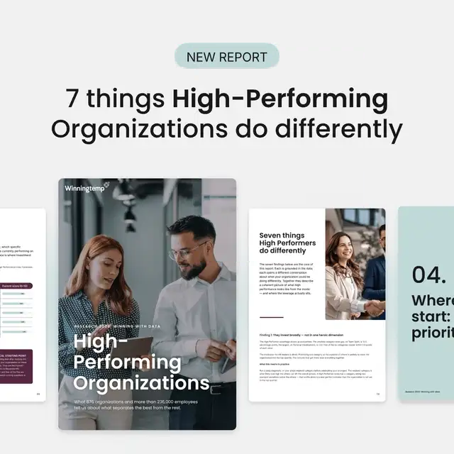
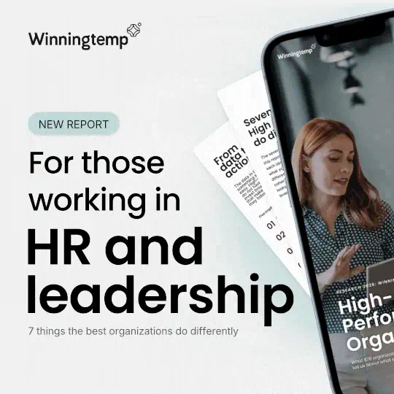
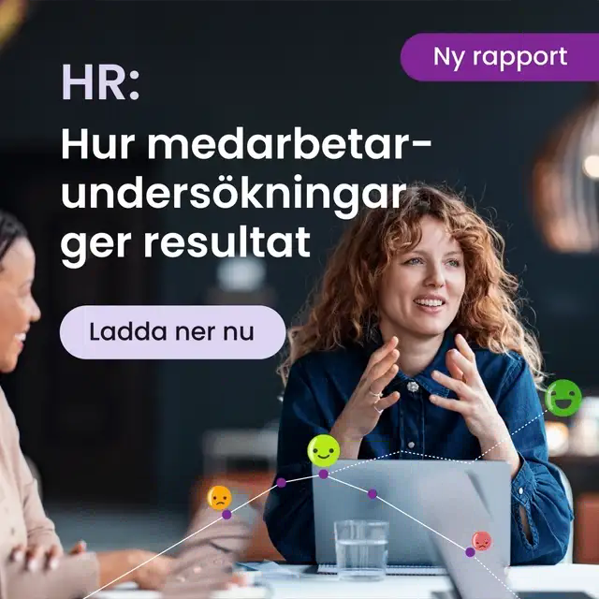
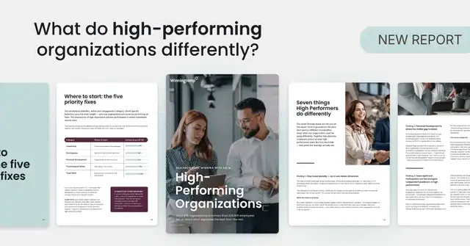
Sign-up creatives that worked
Show the report, name the promise: “7 things high-performing organizations do differently”
HiPO · ROW · Square · List B
HiPO · ROW · Square · HR leadership
HiPO · ROW · Landscape · List question
WinningWay form · SE · GIF 9
16 sign-ups · 184 SEK each
1 sign-up · 263 SEK
4 sign-ups · 741 SEK each
2 sign-ups · 731 SEK each
2 942 SEK · 13 461 impressions
79 clicks · CTR 0.59% · CPM 219 SEK
More than half of all sign-ups in the period.
263 SEK · 2 114 impressions
8 clicks · CTR 0.38% · CPM 125 SEK
Cheap but tiny volume — worth more budget to test.
2 963 SEK · 18 690 impressions
61 clicks · CTR 0.33% · CPM 159 SEK
Same idea in landscape: 4× the cost of the square.
1 462 SEK · 3 887 impressions
25 clicks · CTR 0.64% · CPM 376 SEK
Oldest form creative still converting in Sweden.
Source: LinkedIn Marketing API via CENTCOM · 20 Aug – 16 Sep 2026 vs 23 Jul – 19 Aug · SEK

Slide 11
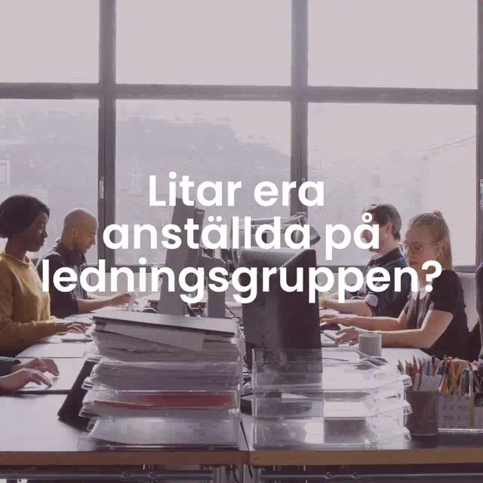
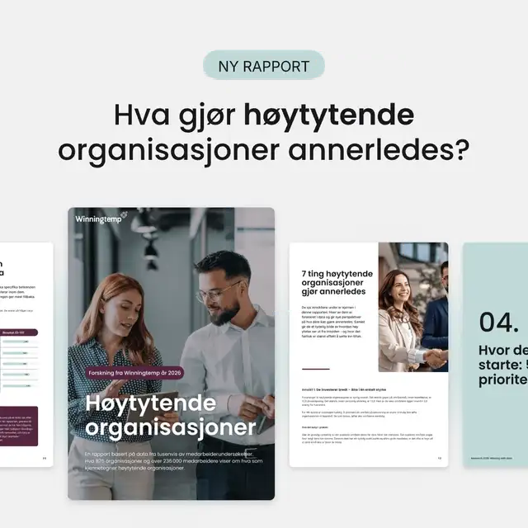
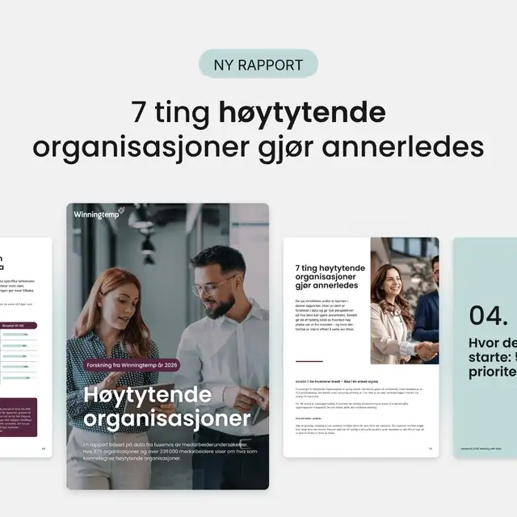
Sign-up creatives that did not
Two patterns: document ads without a hook, and good creatives shown to audiences too small to deliver
Document ad
26 | AO | TOFU | ROW | HiPO | Document Ads
No preview available from LinkedIn
HiPO · ROW · Document ad
HiPO · SE · Square · Institutional trust
HiPO · NO · Square · List question
HiPO · NO · Square · List B
2 sign-ups · 1 651 SEK each
0 sign-ups
1 sign-up · 1 226 SEK
0 sign-ups
3 302 SEK · 28 541 impressions
47 clicks · CTR 0.16% · CPM 116 SEK
9× the cost of the square GIF in the same audience.
1 980 SEK · 987 impressions
4 clicks · CTR 0.41% · CPM 2 006 SEK
Stock office photo, no report, no promise.
1 226 SEK · 122 impressions
1 clicks · CTR 0.82% · CPM 10 046 SEK
Winning concept — but only 122 impressions.
834 SEK · 113 impressions
2 clicks · CTR 1.77% · CPM 7 381 SEK
The ROW winner, translated. 113 impressions.
Source: LinkedIn Marketing API via CENTCOM · 20 Aug – 16 Sep 2026 vs 23 Jul – 19 Aug · SEK

Slide 12
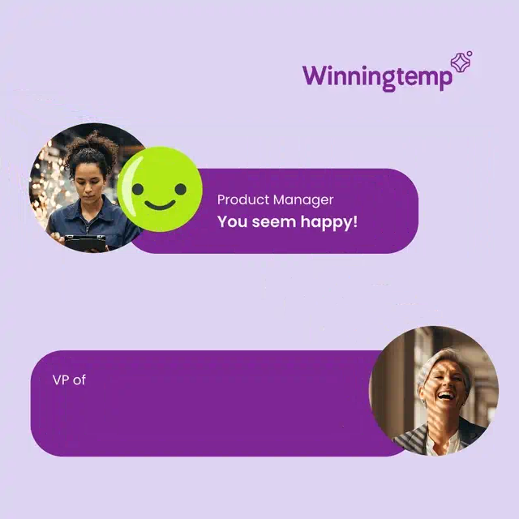
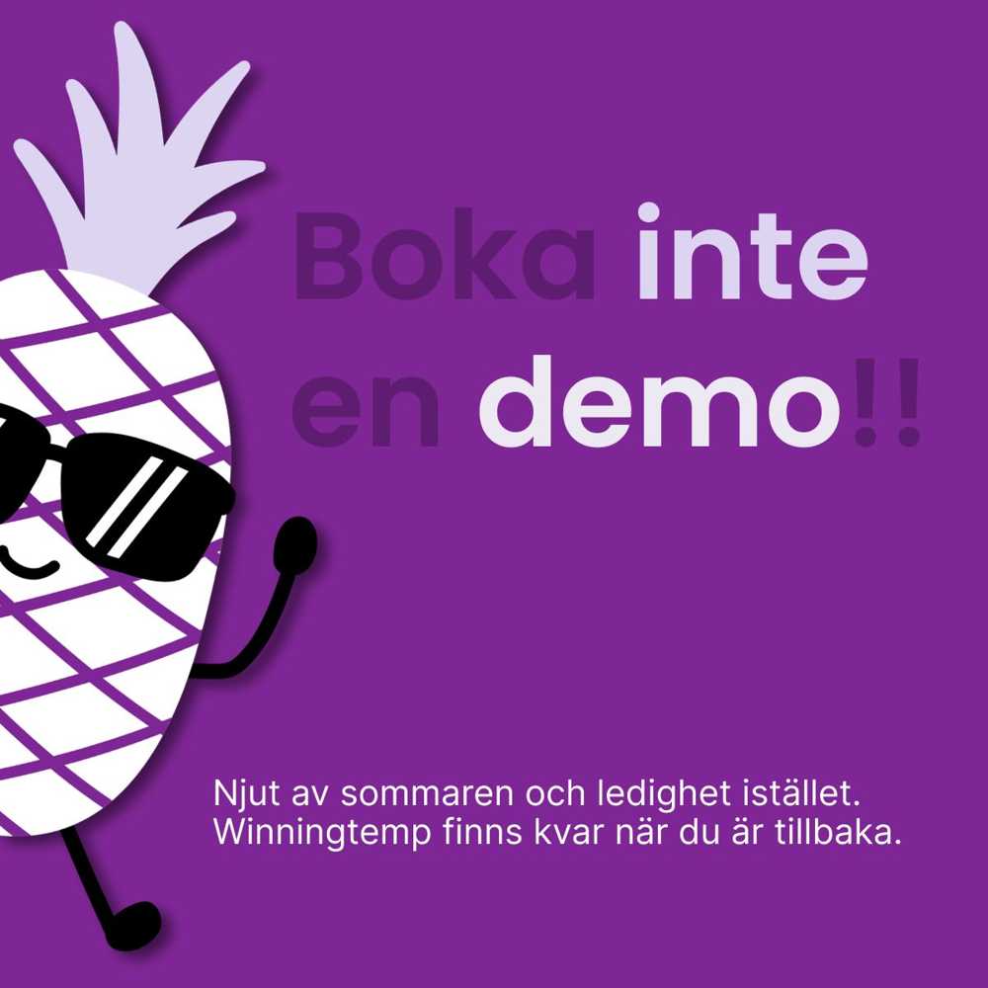
Traffic and demo creatives that worked
A sharp point of view earns the click; the pineapple earns the demo
Document ad
Video · portrait
Your employees are talking. You're just not doing anything about it.
Next-gen listening · portrait video B (HR)
No preview available from LinkedIn
No preview available from LinkedIn
ROW · Document ad · “Your employees are talking”
MOFU · ROW · Portrait video B
TOFU · ROW · Next Gen Listening · GIF D
BOFU · SE · “Boka inte en demo!!”
5 conversions · 791 SEK each
130 clicks · 42 SEK per click
CPM 108 SEK
1 conversion · 949 SEK
3 957 SEK · 30 366 impressions
56 clicks · CTR 0.18% · CPM 130 SEK
5 415 SEK · 48 001 impressions
130 clicks · CTR 0.27% · CPM 113 SEK
Cheapest qualified traffic in the account.
2 048 SEK · 19 017 impressions
21 clicks · CTR 0.11% · CPM 108 SEK
Efficient reach for the remarketing pool.
949 SEK · 2 814 impressions
6 clicks · CTR 0.21% · CPM 337 SEK
Humour and a reverse CTA. Small budget so far.
Source: LinkedIn Marketing API via CENTCOM · 20 Aug – 16 Sep 2026 vs 23 Jul – 19 Aug · SEK

Slide 13
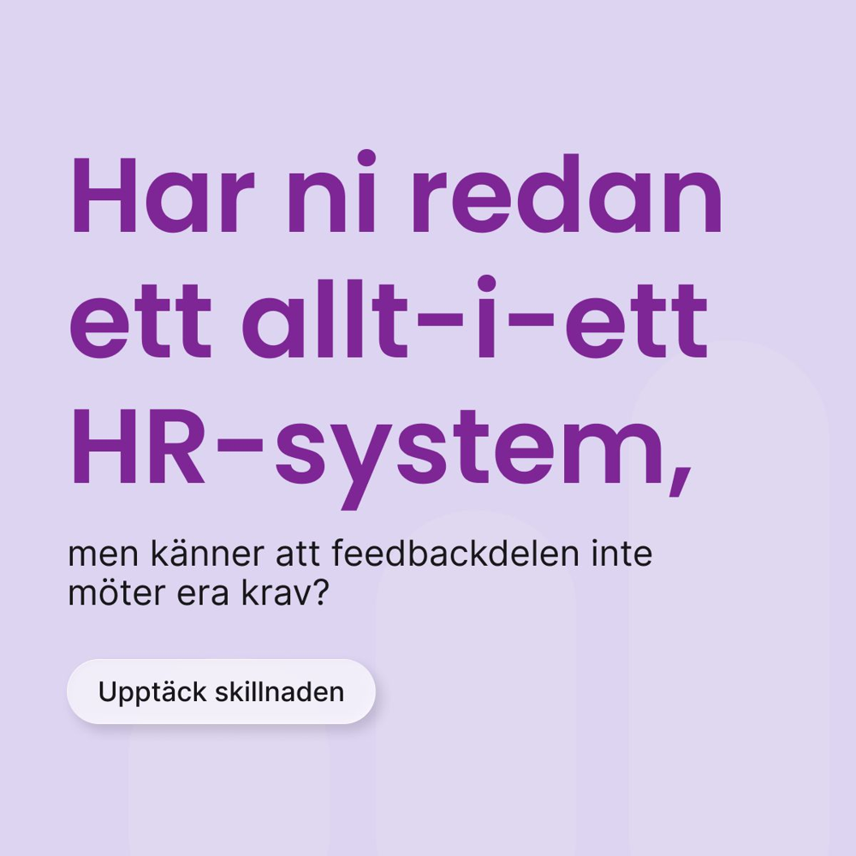
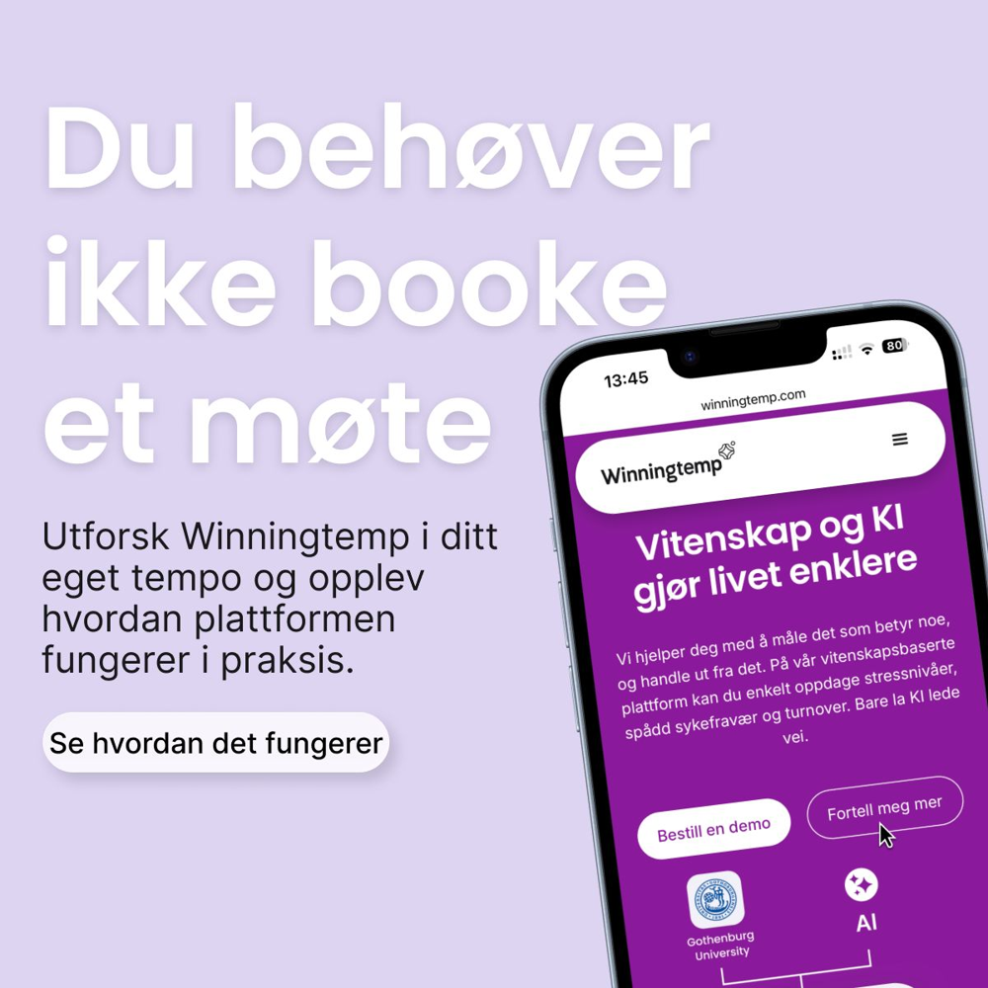
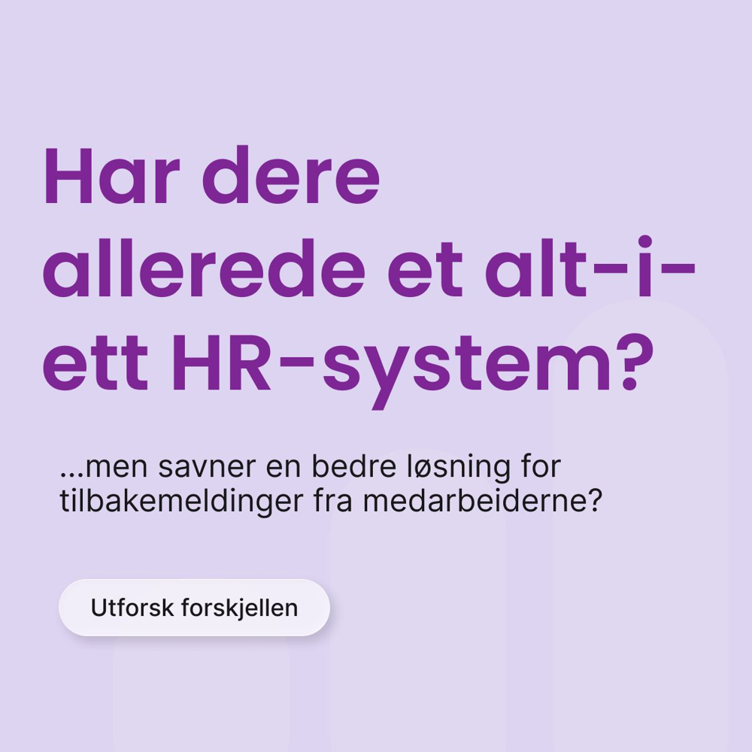
Traffic and demo creatives that did not
The biggest spender in the account produced no conversions — text-only stills are expensive clicks
BOFU · SE · “Har ni redan ett allt-i-ett HR-system”
BOFU · NO · Demo remarketing A
BOFU · NO · Demo remarketing B
0 conversions · 128 SEK per click
0 conversions · 157 SEK per click
0 conversions · 133 SEK per click
5 776 SEK · 12 106 impressions
45 clicks · CTR 0.37% · CPM 477 SEK
Highest-spend creative of the period.
2 674 SEK · 4 684 impressions
17 clicks · CTR 0.36% · CPM 571 SEK
Summer message still running in September.
2 522 SEK · 3 638 impressions
19 clicks · CTR 0.52% · CPM 693 SEK
Same question-headline format as the SE still.
Source: LinkedIn Marketing API via CENTCOM · 20 Aug – 16 Sep 2026 vs 23 Jul – 19 Aug · SEK

Slide 14
Winners and losers, side by side
What separates them is consistent across campaigns
What the winners share
What the underperformers share
• The product of the ad is visible: the report cover and pages, not a mood image
• A concrete promise in the headline (“7 things…”)
• Square format — 184 SEK per sign-up against 741 SEK in landscape
• An audience big enough to deliver: ROW CPM 157 SEK
• Motion (GIF, video) for reach; a strong opinion for clicks
• Generic stock photo or text-only still with a question headline
• Document ads in lead gen: 1 651 SEK per sign-up
• SE and NO audiences so narrow that CPM reached 1 700–5 600 SEK
• Seasonal copy left running after the season
• Spend concentrated early on one untested BOFU still

Slide 15
How to read the 63 conversions
Most are HubSpot demo bookings matched back to anyone who saw an ad in the last 90 days
Conversion rule | Count | Attribution window
CAPI – HubSpot direct (demo booked) | 43 | 90-day click, 90-day view
LinkedIn Conversion API (lead) | 12 | 90-day click, 30-day view
MQL · Book demo · Product SE (pixel) | 5 | 30-day click, 90-day view
CAPI – Closed won (HubSpot) | 3 | 90-day click, 90-day view
The stricter view
1
meeting credited to LinkedIn Ads by HubSpot first-touch source, January–August 2026.
The truth sits between 1 and 63. Sign-ups are the number we can count without argument — use them as the primary KPI until a click-only conversion view is set up.
• The HubSpot stream went live on 20 Aug, so this is the first full period with it.
• SE Spotlight shows 26 conversions from 12 clicks; one brand GIF shows 12 from 1 click. Those are view-through matches, not ad-driven bookings.
Source: LinkedIn conversion pivot, 20 Aug – 16 Sep · HubSpot first-touch attribution from CENTCOM funnel (actuals to Aug 2026)

Slide 16
AI visibility in Sweden
02.

Slide 17
Videntic: Sweden account status
“Well positioned” — visibility score 23, up from 5 in June
Visibility score
Share of voice (weighted)
Citation share
Sentiment
23
22.5%
26.8%
79 / 100
Tier: well positioned
25.8% at last check
140 of 523 tracked citations
85 positive · 3 negative answers
Visibility score, last 90 days
Source: Videntic, WT Sweden (winningtemp.com, sv) · 2026-06-12 – 2026-09-17 · ChatGPT, Gemini, Google AI Overview, Perplexity

Slide 18
Where we show up, and where we don't
Strongest in Google AI Overview, weakest in Perplexity — and we lead the citation table
Answers that mention Winningtemp (%)
Most-cited domains in Swedish AI answers
Watch-outs and content gaps
• Perplexity score fell from 24 to 13 and share of voice from 25.8% to 22.5% — both flagged as threats by Videntic.
• Highest-impact gaps: Medarbetarundersökningar på flera språk · Medarbetarfeedback · Resultatanalys · Medarbetarundersökningsmallar.
Source: Videntic, WT Sweden · mention rate = share of 100 tracked prompts per provider where Winningtemp is named

Slide 19
Organic search
03.

Slide 20
Ahrefs: organic search in Sweden
Third-largest organic footprint among direct competitors — built on far fewer keywords
Estimated monthly organic traffic, Sweden
Domain | DR | Keywords | Top 3
brilliantfuture.se | 52 | 308 | 99
eletive.com | 55 | 69 | 22
hibob.com | 81 | 135 | 44
Winningtemp | 49 | 50 | 20
questback.com | 78 | 98 | 33
heartpace.com | 47 | 82 | 31
haileyhr.com | 46 | 42 | 20
talentech.com | 70 | 170 | 43
Brilliant Future ranks for 308 tracked keywords in Sweden. We rank for 50.
Source: Ahrefs API v3 via CENTCOM · Swedish market · estimated monthly organic traffic · pulled 2026-09-17

Slide 21
Our search traffic is our own name
93% of Swedish organic traffic comes from people already searching for Winningtemp
Domain Rating
Organic traffic SE / month
Keywords in top 3, SE
Traffic value SE / month
49
2 578
20
$1 604
Eletive 55 · Brilliant Future 52
NO 609 · UK 89
of 50 ranking keywords
what the clicks would cost in ads
The category terms with volume — and who holds them
Keyword | Searches / mo | Who ranks today | Winningtemp
medarbetarsamtal | 3 200 | Miljödata, Wise, Sympa | Not in top 8
enps | 1 200 | BambooHR, Personio | Not in top 8 (NO: #1)
medarbetarundersökning | 1 200 | Questback, Zondera, GPTW | Not in top 8
medarbetarenkät | 900 | Prevent, Sunt arbetsliv | Not in top 8
företagskultur | 400 | Winningtemp, Svedea | #1–3
pulsmätning | 300 | Vårdhandboken, Questback | Not in top 8
Source: Ahrefs API v3 via CENTCOM · volumes are monthly searches in Sweden · positions from Ahrefs SERP scans

Slide 22
Website
04.

Slide 23
GA4: website traffic
Fewer visits than last year, and the gap opened in the first half
Sessions YTD
Users YTD
Page views YTD
Avg. session duration
93 157
47 552
121 076
1m 42s
-8% vs 2025
-18% vs 2025
+18% vs 2025
1m 26s in 2025
Sessions per month
Source: GA4 property 304968910, all countries · 1 Jan – 16 Sep 2026 vs same dates 2025 · September 2026 is 1–16 Sep

Slide 24
GA4: where visits come from
Paid search is now the largest channel; direct and organic both shrank by a quarter or more
Sessions by channel, year to date
Read with care
• GA4 organic sessions are down 25% while Search Console clicks are up 73%. Both cannot be true — the difference is most likely consent and tagging, not demand.
• Engagement rate jumped from 42% to 77% and key events from 22k to 187k since August 2025. That is a configuration change, so neither is comparable year on year.
• Paid Social (LinkedIn) sessions: 696, up from 186.
Source: GA4, session default channel group · 1 Jan – 16 Sep, 2026 vs 2025

Slide 25
Search Console: Google visibility
Clicks up 73%, impressions doubled, average position from 38 to 15
Clicks YTD
Impressions YTD
Average position
Non-brand clicks YTD
17 964
1 573 622
14.8
1 940
+73% vs 2025
+108% vs 2025
38.4 in 2025
+88% vs 2025
Weekly clicks 2026, brand vs non-brand
Source: Google Search Console, sc-domain:winningtemp.com · 1 Jan – 16 Sep 2026 vs same dates 2025 · weekly clicks, all countries

Slide 26
Search Console: markets and category terms
Sweden drives the growth; category terms are visible but still rank on page two
By market
Category terms
Market | Clicks | Change | Position
Sweden | 9 710 | +78% | 22 → 14
Norway | 1 775 | +67% | 29 → 14
United Kingdom | 922 | +47% | 49 → 23
Queries containing | Impressions | Clicks | Position
medarbetarundersökning | 21 577 | 17 | 27 → 17
medarbeider | 34 243 | 37 | 38 → 21
employee survey | 43 428 | 5 | 58 → 38
employee engagement | 56 071 | 36 | 51 → 32
engagement | 75 865 | 42 | 51 → 31
engagemang | 8 250 | 2 | 24 → 23
Top non-brand queries in Sweden: lunch and learn, enps, enps skala, företagskultur.
Impressions are there. Position 15–35 means few clicks — the same gap Ahrefs shows.
Source: Google Search Console · 1 Jan – 16 Sep 2026 vs same dates 2025 · category = all queries containing the term

Slide 27
What we do next
Proposed actions for the coming four weeks
Scale the winner Move budget to the ROW square “List B” report GIF and build three new square variants on the same structure.
Fix SE and NO before relaunching Widen the HiPO audiences until forecast CPM is below 300 SEK. The creatives are not the problem.
Stop what does not pay Pause HiPO document ads in lead gen, the NO summer remarketing pair and the SE “allt-i-ett” still. That frees about 14 000 SEK per period.
Make conversions countable Add a click-only conversion view in Campaign Manager so creative decisions are not made on view-through matches.
Turn visibility into traffic Publish pillar pages for medarbetarundersökning and medarbetarsamtal — the same gaps Videntic and Ahrefs both point to.
Check the GA4 setup Review consent mode and key-event configuration so website numbers can be trusted again.

Slide 28
Questions?

