Slide 1
CPR: Creatives on LinkedIn and Meta
Campaign Performance Review · 5 – 14 October 2026 · what changed since the review on 5 October

Slide 2
The short version
Ten days since the last CPR — what the creatives did on LinkedIn and Meta
LinkedIn spent 29% more (24 967 SEK) for fewer clicks and sign-ups: 8 at 3 121 SEK. The extra money went to a new conversation ad (4 432 SEK, 1 click) and the G2-quote GIFs in DK&FI (6 685 SEK, 26 clicks at 257 SEK).
The “7 things” GIF still carries lead gen (5 of 8 sign-ups) at 506 SEK each — over the 350 SEK fatigue line. Its successors launched on 14 October; no data yet.
Of the five 5-October actions, the successors are done; the GIF test moved market instead of widening, the NO Boost spent 1 461 SEK against a 1 000 SEK cap, and Meta's lead ads paused at their budget ceiling on 13 October.
Video and document ads remain the traffic engine (52 clicks at 41 SEK, 24 at 93 SEK). The two creatives flagged in September spent nothing.
Meta: 28% less spend, more clicks (366), 24 lead-form sign-ups at 86 SEK — a sixth of LinkedIn's price — until the budget ceiling paused them. The NO Sommergraf video buys link clicks at 4 SEK.
HubSpot booked 11 demos (5 from paid search); none traces back to LinkedIn or Meta. The BOFU GIFs are judged on clicks: 26 of the agreed 300 so far.

Slide 3
What this review covers
01
LinkedIn since the last CPR
02
October's actions revisited
03
LinkedIn creatives
04
Format scorecard
05
Meta: account and creatives
06
What we do next

Slide 4
LinkedIn since the last CPR
More spend, fewer clicks and sign-ups, costlier everything
SPEND
CLICKS · CTR
LEAD-GEN SIGN-UPS
DEMOS BOOKED (HUBSPOT)
24 967 SEK
214 · 0.19%
8
11
+29% vs previous 10 days
19 328 SEK previous
133 landing-page clicks · 117 SEK per click
243 · 0.24% previous
3 121 SEK each · 5 from the “7 things” GIF
10 · 1 933 SEK previous
5 paid search · 0 paid social
8 previous · 0 paid social
Spend per week, SEK (weeks start Thursday)
Lead-gen sign-ups per week
Source: LinkedIn Marketing API via CENTCOM · 5–14 Oct 2026 vs 25 Sep–4 Oct 2026 (equal 10-day windows) · SEK · demos = New Sales Pipeline deals created, HubSpot

Slide 5
What happened to October's actions
Five agreed on 5 October — one done, four open
Action agreed 5 Oct | Status | What the data shows
Give the winner a successor: three square “7 things” variants in a separate ROW campaign, 1 500 SEK each | Done 14 Oct | Successors built and launched on 14 October — no data in this window yet. Until then the winner took 88% of the campaign (2 530 of 2 926 SEK); the seven old sisters got 44–110 SEK each.
Fatigue rule: rotate the winner out at >350 SEK per sign-up two weeks running | Triggering | Cost per sign-up by week: 292 → 307 → 302 → 429 SEK (week of 8 Oct). 5 sign-ups at 506 SEK in this window — first week over the line; decide now.
Give the G2-quote GIFs a fair test: widen audiences until CPM <400, add UTMs, judge on LP clicks <150 SEK and demos after 300 clicks | Done | Budget moved to the English DK&FI set: 6 685 SEK, CPM 1 233, 26 landing-page clicks at 257 SEK. SE (140 SEK) and NO (0) paused. 26 of the 300 clicks reached; 0 demos in HubSpot from paid social.
Keep video + document as the traffic engine; cap the NO Boost at 1 000 SEK | Half done | Video: 52 clicks at 41 SEK, CPM 122 — cheapest again. Document: spend +62% to 2 220 SEK, 24 clicks at 93. NO Boost: 1 461 SEK in ten days, 4 clicks — over the cap.
Meta: verify the NO sign-ups, then scale Guide HIPO C and A, launch an SE copy, move half the reach-video budget | Paused by the budget ceiling | 24 sign-ups at 86 SEK up to 13 Oct, when the campaign's 250 SEK/day budget ran out and it paused. Lead-ad spend 2 306 → 2 067 SEK; no SE copy yet; reach videos still 2 026 SEK for 12 link clicks.
Not in the plan: a LinkedIn conversation ad (“Winning with data”, SE) went live and took 4 432 SEK — 18% of the period's spend — for 92 sends, 41 opens and 1 click – test ends tomorrow.
Source: LinkedIn Marketing API and HubSpot CRM via CENTCOM · campaign and creative status and spend, 5–14 Oct 2026

Slide 6
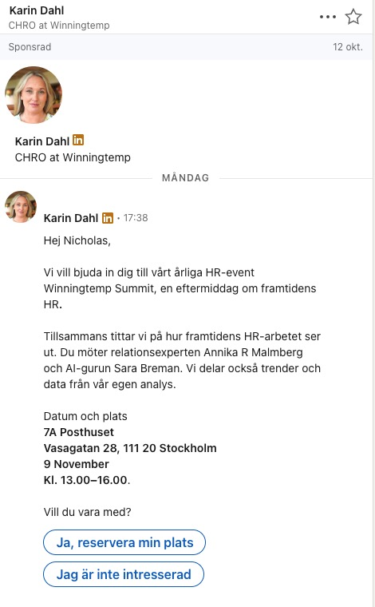
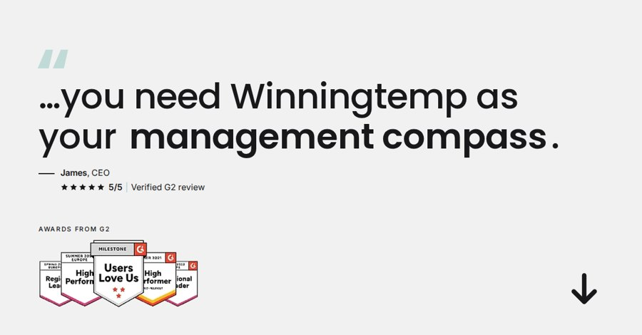
Where the extra 5 600 SEK went
Two new things, no result yet
NEW · MOFU · SE · conversation ad “Winning with data”
BOFU · DK&FI → ENG · G2-quote GIFs (4 ads; SE version shown)
4 432 SEK · 92 sends · 1 click
6 685 SEK · 26 clicks · 257 SEK/click
no preview
48 SEK per send · 41 opens (45%) · 108 SEK per open
One click on the message, no sign-up, no demo.
18% of the period's LinkedIn spend, launched since the last CPR.
* Test ends tomorrow
5 420 impressions · CTR 0.48% · CPM 1 233 SEK
Previous 10 days: 771 SEK; the SE set fell to 140 SEK, NO to 0.
All 26 are landing-page clicks · 0 demos in HubSpot.
WHAT IT MEANS
The spend increase (+5 600 SEK vs the previous ten days) is these two items. Neither has produced a sign-up or a demo yet; both are early. BOFU DK&FI → The audience is still too narrow to judge the creative in these markets.
Source: LinkedIn Marketing API via CENTCOM · 5–14 Oct 2026 vs 25 Sep–4 Oct 2026 (equal 10-day windows) · SEK

Slide 7
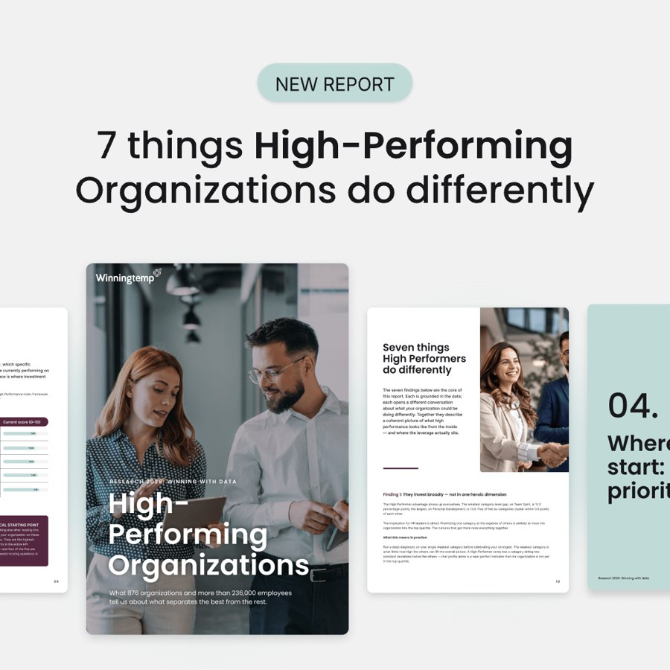
The sign-up winner has crossed the fatigue line
“7 things” still brings the sign-ups — at four times the September price
HIPO · ROW · SQUARE · “7 THINGS” (LIST B)
Cost per sign-up per week, SEK (fatigue line 350)
5 sign-ups · 506 SEK each
2 530 SEK · 8 021 impressions · 38 clicks
CTR 0.47% · CPM 315 SEK
Previous 10 days: 2 210 SEK.
Still 5 of the account's 8 sign-ups — and still the only creative that brings them in at scale. Cost per sign-up has quadrupled since early September.
The old sister variants are still starved: seven ads shared 356 SEK. The rule agreed on 5 Oct says rotate the winner out at two weeks above 350 SEK — the week of 8 Oct is the first (429 SEK). The successors launched on 14 Oct; the next review judges them.
Source: LinkedIn Marketing API via CENTCOM · 5–14 Oct 2026 vs 25 Sep–4 Oct 2026 (equal 10-day windows) · SEK · weekly cost per sign-up from daily creative analytics

Slide 8
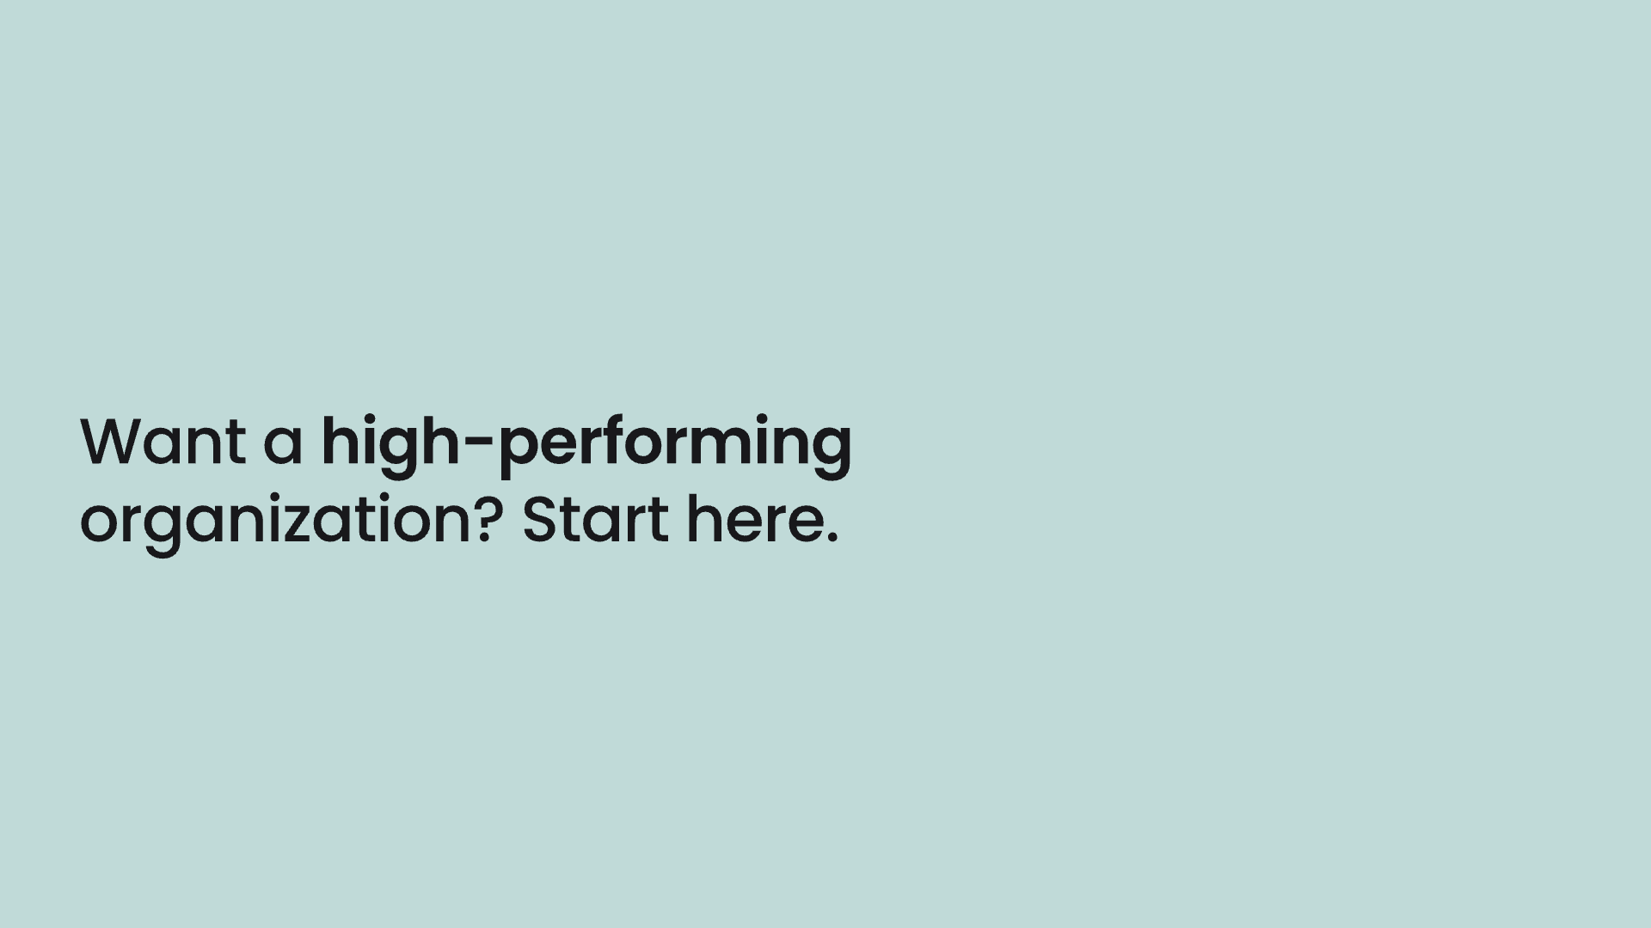

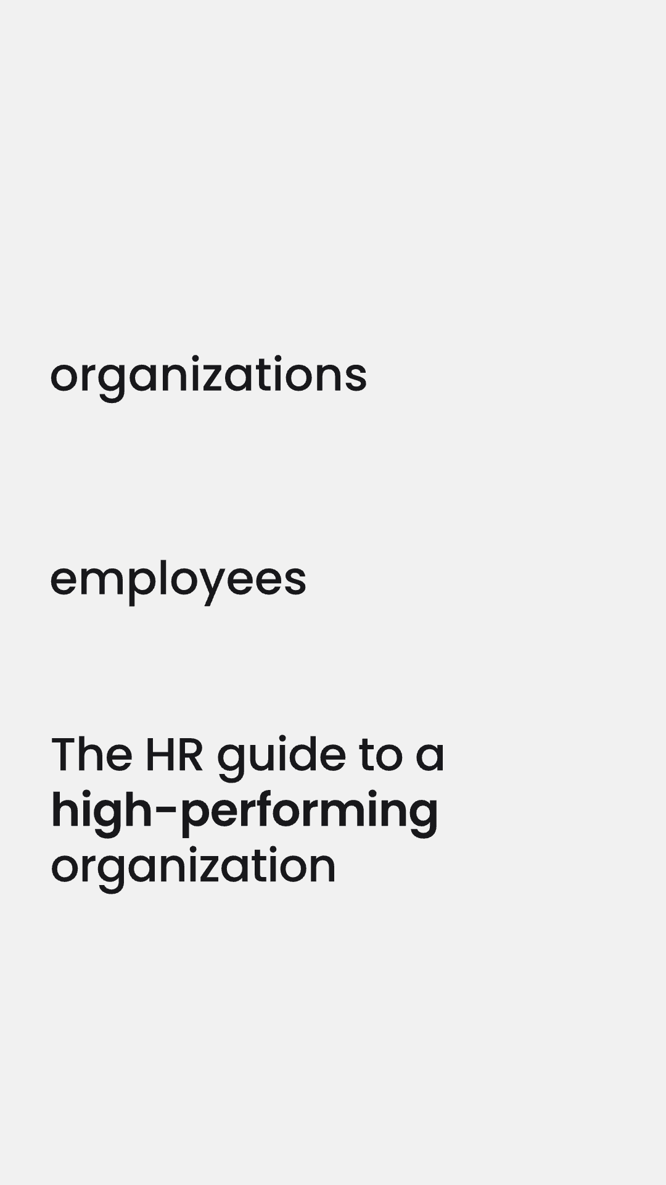
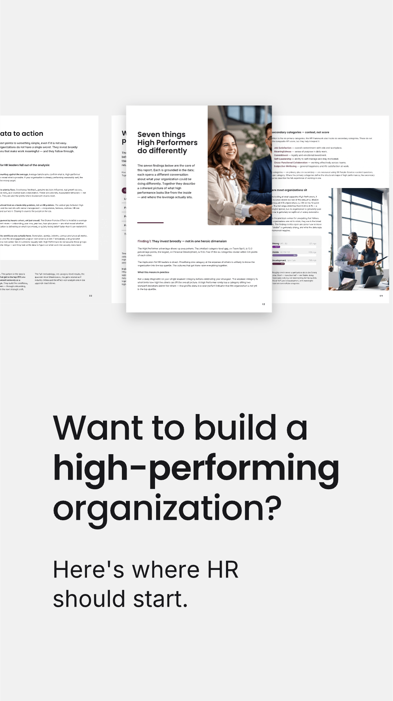

HPO report – Refresher creatives [14 Oct]
Rules
3 seconds
Iq80
Amy Diamond (Whats in it for me?)
3 Vertical & 2 Horizontal. Focus: Clear+concise message & offering
Source: LinkedIn Marketing API via CENTCOM · 5–14 Oct 2026 vs 25 Sep–4 Oct 2026 (equal 10-day windows) · SEK · weekly cost per sign-up from daily creative analytics

Slide 9

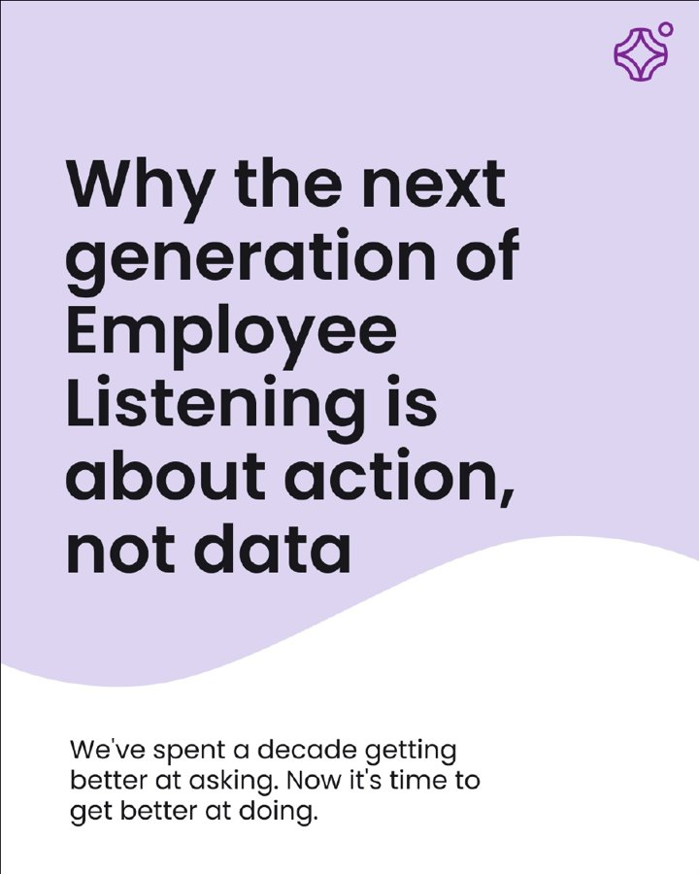
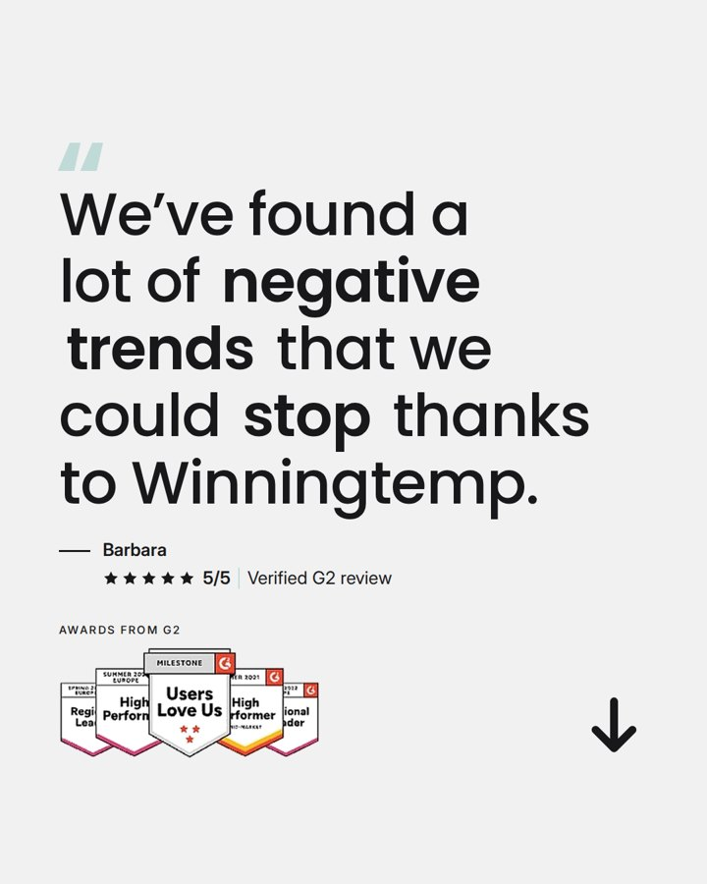
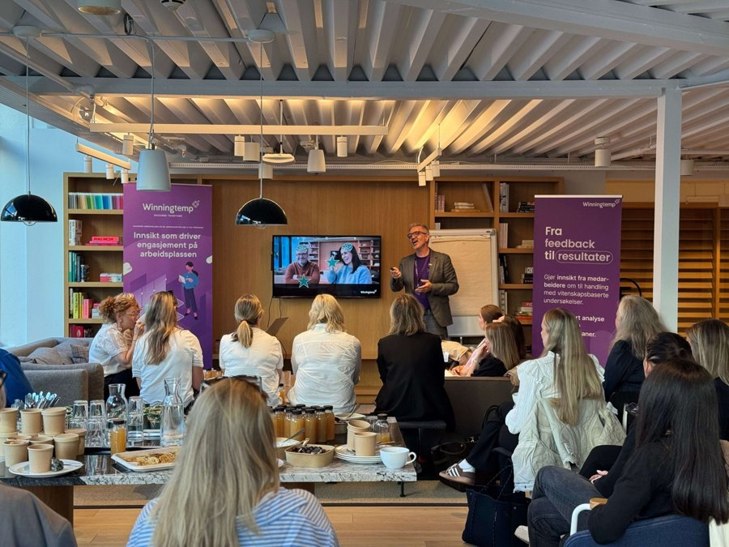
Traffic creatives
Video and document still buy the cheap clicks; the NO Boost spent 1.5× its four-week cap in ten days
MOFU · ROW · “NEXT GEN LISTENING” VIDEO
DK&FI · DOCUMENT AD (“YOUR EMPLOYEES ARE TALKING…”)
52 clicks · 41 SEK/click
24 clicks · 92 SEK/click
2 122 SEK · 17 364 impressions
CTR 0.30% · CPM 122 SEK · 6 690 views
Cheapest clicks in the account for the third review running.
2 220 SEK (+62%) · 11 702 impressions
CTR 0.21% · CPM 190 SEK
Cheap reach; the budget rose without a decision to raise it.
BOOST · NO · TWO POSTS · BOTH STOPPED 13 OCT
BOFU · DK&FI → ENG · G2-QUOTE GIFS (SE VERSION SHOWN)
4 610 SEK · 63 clicks
6 685 SEK · 26 clicks · 257/click
While they ran: “Gjør det du!” 3 361 SEK · 58 clicks (16 Sep–13 Oct); the second post 1 249 SEK · 5 clicks (23 Sep–13 Oct).
This window: 1 461 SEK · 4 clicks vs a 1 000 SEK four-week cap.
5 420 impressions · CTR 0.48% · CPM 1 233 SEK
Budget moved from SE/NO (771 SEK previous) to the English DK&FI set.
All 26 are landing-page clicks · 0 demos in HubSpot.
Source: LinkedIn Marketing API via CENTCOM · 5–14 Oct 2026 vs 25 Sep–4 Oct 2026 (equal 10-day windows) · SEK

Slide 10
Format scorecard
Spend and results by creative format, all campaigns in the period
Format | Ads | Spend | Impr. | CTR | CPM | Clicks | CPC | Sign-ups | LP clicks | Cost per result
GIF (HiPO + BOFU + TOFU) | 47 | 12 624 | 35 128 | 0.29% | 359 | 102 | 124 | 7 | 39 | 1 803 / sign-up
Conversation ad | 1 | 4 432 | 92 sends | 45% open | 48 / send | 1 | 4 432 | 0 | 1 | — (1 click)
Document | 3 | 3 076 | 19 578 | 0.17% | 157 | 33 | 93 | 1 | 28 | 110 / LP click
Video | 6 | 2 395 | 18 703 | 0.32% | 128 | 59 | 41 | 0 | 53 | 45 / LP click
Boost (organic posts) | 2 | 1 461 | 116 | — | — | 4 | 365 | 0 | 1 | — (4 clicks)
Image (stills, spotlight) | 23 | 979 | 36 732 | 0.04% | 27 | 15 | 65 | 0 | 11 | 89 / LP click
Sign-ups still come from one GIF; the rest of the GIF family (46 ads) is BOFU clicks and starved TOFU variants. Video remains the cheapest way to buy a landing-page click (45 SEK), documents the cheapest reach (CPM 157). The conversation ad is the most expensive item per result in the account's history: 4 432 SEK for one click 💀
Source: LinkedIn Marketing API via CENTCOM · 5–14 Oct 2026 vs 25 Sep–4 Oct 2026 (equal 10-day windows) · SEK · all campaigns with spend in the period

Slide 11
Meta since the last CPR
Less spend, more clicks, 24 sign-ups at a sixth of LinkedIn's price
SPEND
LINK CLICKS · CTR
LEAD-FORM SIGN-UPS
REACH VIDEOS
4 942 SEK
366 · 0.24%
24
2 026 SEK
-28% vs previous 10 days
6 870 SEK previous
14 SEK per link click
336 · 0.14% previous
86 SEK each · campaign paused 13 Oct at its budget ceiling
33 · 75 SEK previous
3 videos · 12 link clicks · CPM 15 SEK
2 487 SEK previous
Spend per week, SEK (weeks start Thursday)
Lead-form sign-ups per week
Source: Meta Marketing API via CENTCOM · 5–14 Oct 2026 vs 25 Sep–4 Oct 2026 (equal 10-day windows) · SEK

Slide 12
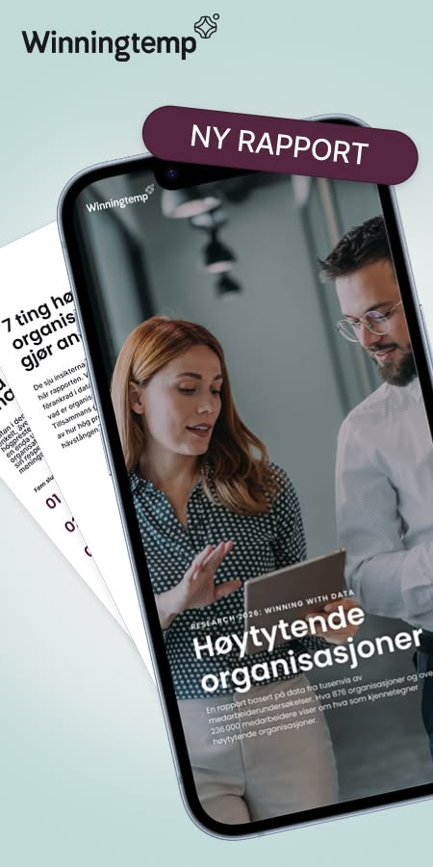
Meta creatives
The two report ads do the work; the reach videos still take 41% of the budget
GUIDE HIPO C · NO · LEAD FORM
GUIDE HIPO A · NO · LEAD FORM
14 sign-ups · 85 SEK each
10 sign-ups · 88 SEK each
1 189 SEK (prev 1 757) · 6 710 impressions
83 link clicks · CTR 1.24% · CPM 177 SEK
Paused 13 Oct when the 250 SEK/day ceiling ran out; sign-ups 19 → 14.
877 SEK (prev 549) · 5 126 impressions
65 link clicks · CTR 1.27% · CPM 171 SEK
The two report ads: 24 sign-ups for 2 067 SEK. LinkedIn pays 506 SEK for the same promise.
SOMMERGRAF C (+B) · NO · PROSPECTING VIDEO
205 link clicks · 4 SEK each
no preview
847 SEK · CTR 4.05% · CPM 165 SEK
70 landing-page views. The cheapest traffic on either platform —
but nothing downstream is measured for it yet (no form, no demo).
Source: Meta Marketing API via CENTCOM · 5–14 Oct 2026 vs 25 Sep–4 Oct 2026 (equal 10-day windows) · SEK · previews from the Meta creative library

Slide 13
Proposed actions for the coming four weeks
What we do next
Rotate the winner, judge the successors
Widen the G2 GIF BOFU audience
conversation ad stops tomorrow
The fatigue line is crossed: move the budget to the successors launched 14 Oct, even rotation, 1 500 SEK each — verdict at the next review.
DK&FI runs at CPM 1 233. Add job functions and company sizes until CPM is under 400; add UTMs; keep the 300-click verdict (26 so far).
Unless next 100 sends bring in 10 signups
NO – more org Boosts & Snapchat activation
Meta: lift the ceiling, scale what works
Guide HIPO A and C paused at 250 SEK/day with sign-ups at 86 SEK. Raise the ceiling by 50% for next month. Take NO money from linkedin.

Slide 14
Questions?

