Slide 1
CPR: Creatives on LinkedIn and Meta
Campaign Performance Review · 17 Sep – 4 Oct 2026

Slide 2
The short version
Eighteen days since the last CPR — what the creatives did on LinkedIn and Meta
One creative still carries lead gen 17 sign-ups in the period; 16 of them from the square “7 things” report GIF in ROW, at 268 SEK each.
Lead gen got cheaper by stopping, not by scaling Cost per sign-up across lead-gen campaigns fell from 743 to 528 SEK because the SE/NO report campaigns and the document ads were paused. The winner's budget was not increased.
Early fatigue on the winner Cost per sign-up has climbed from 125 SEK (week of 3 Sep) to about 300 SEK; CTR from 0.77% to 0.41%. It still delivers 5–6 sign-ups a week, but it needs a successor.
The new BOFU GIFs earn the click, not yet the demo Six G2-quote GIFs in SE, NO and DK/FI: CTR 0.43–0.85% (account 0.24%) but 222 SEK per click because the audiences are small. No demo in HubSpot traces back to them yet — 31 clicks is too few to tell.
Traffic: the video and the document still win The “Next gen listening” video bought 105 clicks at 35 SEK; the “about action” document ad has the cheapest reach (CPM 119). Two creatives flagged in September are still running.
Meta: the same report, a quarter of the price The NO “Guide HIPO” lead ads launched 25 Sep took 33 sign-ups at 75 SEK each; LinkedIn pays 268 SEK for the same promise.

Slide 3
Agenda
What this review covers
01
LinkedIn: account since the last CPR
Spend, sign-ups and clicks week by week, and what happened to September's actions
02
LinkedIn: the creatives
The sign-up winner and its fatigue, the starved variants, the new BOFU GIFs, traffic creatives, format scorecard
03
Meta: the creatives
First lead ads on Meta, the reach videos, and cost per sign-up against LinkedIn
04
What we do next
Seven actions for the coming four weeks

Slide 4
LinkedIn since the last CPR
17 Sep – 4 Oct 2026: less spend, fewer impressions, almost the same number of sign-ups — at a lower cost per sign-up
Spend
Clicks · CTR
Lead Gen sign-ups
Cost per sign-up (lead gen)
35 153 SEK
465 · 0.24%
17
528 SEK
-17% vs previous 18 days
536 · 0.18% previous
20 in previous 18 days
743 SEK previous
Weekly spend, SEK
Lead Gen sign-ups per week
Clicks per week
The report launch (26 Aug) pushed weekly spend to 22–24k SEK; since the CPR it sits at 13–15k, yet sign-ups held at 5–7 a week. Cuts: SE demo still, SE/NO report campaigns, four-country Boost. New: the BOFU GIFs and the NO Boost.
■ before the 17 Sep CPR ■ since the CPR
* week of 1 Oct covers four days (1–4 Oct)
Source: LinkedIn Marketing API via CENTCOM · 17 Sep – 4 Oct 2026 vs 30 Aug – 16 Sep (equal 18-day windows) · SEK

Slide 5
What happened to September's actions
Action agreed 17 Sep | Status | What the data shows
Scale the winner, build three square variants | Partly | Winner's spend +52% (2 817 → 4 283 SEK) but the campaign budget is flat and no new variants exist; the other 7 variants share 19% of spend.
Pause the NO summer remarketing pair and the SE “allt-i-ett” still | Not done | Still active: 1 423 SEK (NO pair, 0 conv) + 2 178 SEK (SE still, 1 conv) this period.
Pause the HiPO document ads in lead gen | Done | ROW HiPO document ad: 0 SEK this period. DK version still runs (724 SEK, 0 sign-ups).
Set up a click-only conversion view | Partly | The API now separates them: 4 post-click vs 16 post-view conversions this period. The headline number (21) still mixes both — 10 of them landed on 24 Sep from 2 clicks.
Set up BOFU ads with G2 | Done | Performance on CTR & CPC look good. Needs time
Source: LinkedIn Marketing API via CENTCOM · campaign and creative status and spend, 17 Sep – 4 Oct 2026

Slide 6
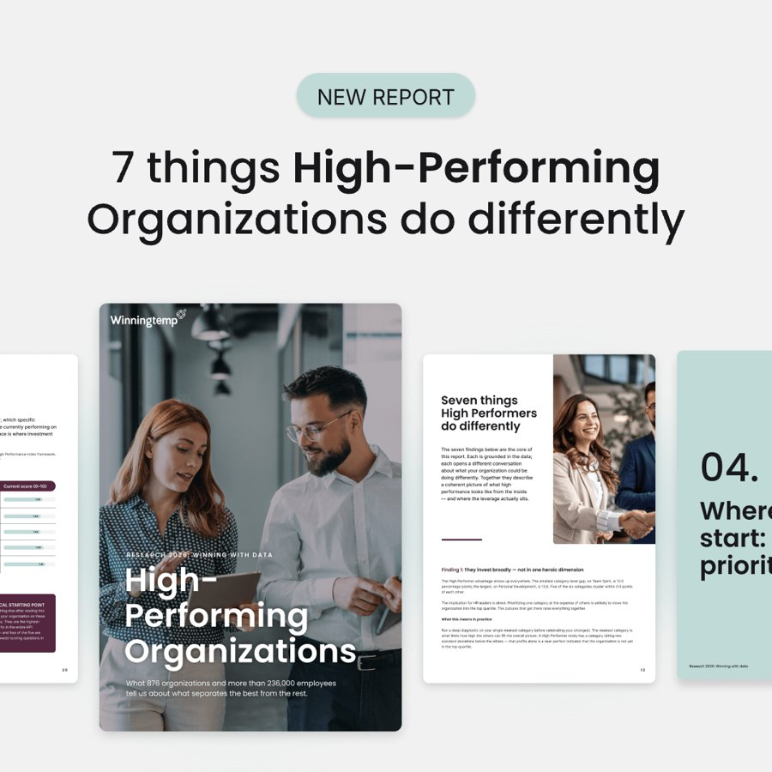
The sign-up creative: one ad, 16 of 17 sign-ups
The square “7 things” report GIF still works — but its cost per sign-up has more than doubled in five weeks
Sign-ups per week (weeks start Thursday)
Cost per sign-up, SEK
CTR per week
Read-out Still 5–6 sign-ups a week, but each one costs 2–3× what it did in early September and CTR has nearly halved. The audience is seeing the same creative again and again. Build the successor now, before the line crosses 350 SEK.
HiPO · ROW · Square · “7 things” (List B)
16 sign-ups · 268 SEK each
4 283 SEK · 19 207 impressions · 87 clicks · CTR 0.45% · CPM 223 SEK
* week of 1 Oct covers four days (1–4 Oct)
■ before the 17 Sep CPR ■ since the CPR
Source: LinkedIn Marketing API via CENTCOM · 17 Sep – 4 Oct 2026 vs 30 Aug – 16 Sep (equal 18-day windows) · SEK

Slide 7

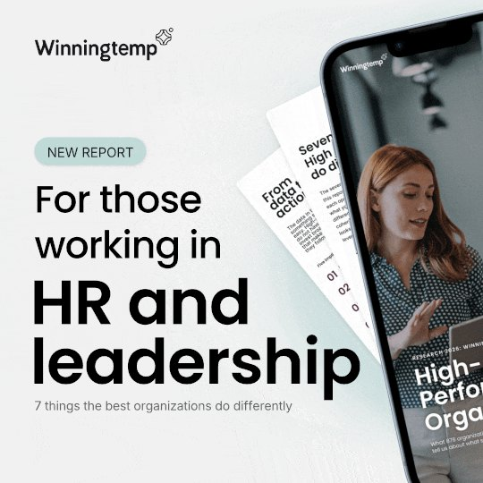
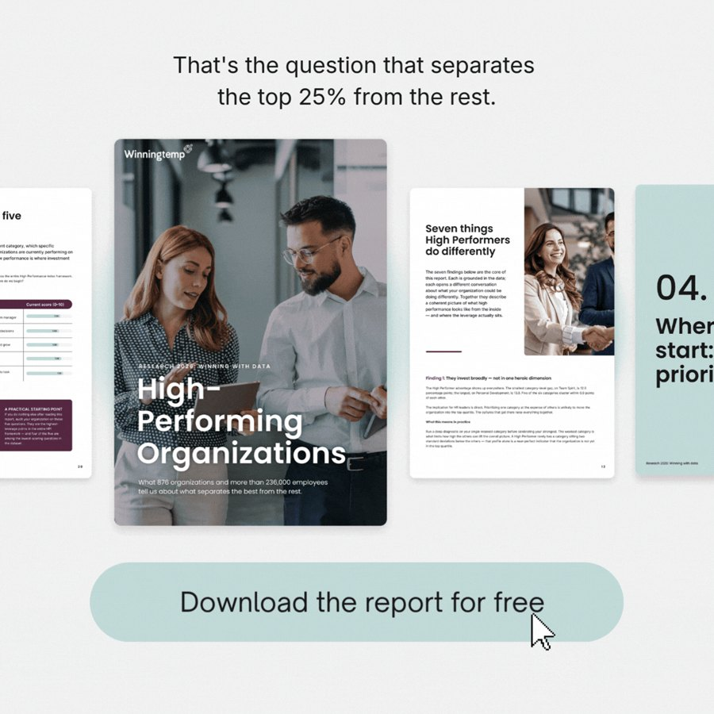
Seven sister variants that never got a chance
LinkedIn's rotation gives 81% of the campaign to one ad — the others have not had enough impressions to be judged
Spend per variant, SEK (sign-ups in brackets)
“Trust the leadership?” photo
“For those in HR” phone
“Top 25%” + button
316 SEK · 1 645 impr.
8 clicks · CTR 0.49%
1 sign-up
109 SEK · 445 impr.
1 clicks · CTR 0.22%
0 sign-ups
244 SEK · 1 047 impr.
3 clicks · CTR 0.29%
0 sign-ups
What this means The 'trust the leadership' photo variant got one sign-up from 316 SEK (CTR 0.49%) — on par with the winner — but then starved. To know which hook comes next, variants need their own campaign with even rotation, or sequential runs of 1 500 SEK each.
Source: LinkedIn Marketing API via CENTCOM · 17 Sep – 4 Oct 2026 vs 30 Aug – 16 Sep (equal 18-day windows) · SEK

Slide 8
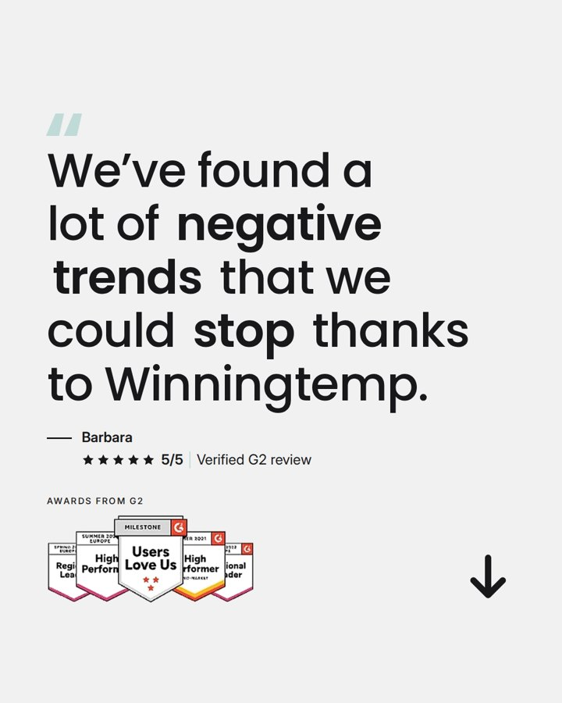
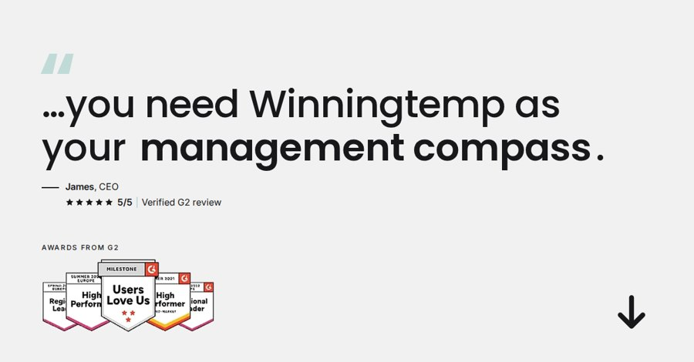
New this period: the BOFU G2-quote GIFs
Built to be clicked, not to collect forms — and they are clicked at 2–3× the account CTR. The cost is the audience, not the creative
Attribution check
0 post-click conversions on the six GIFs (LinkedIn, 17 Sep – 4 Oct). Account total: 4 post-click, 16 post-view.
0 of 13 demo bookings in HubSpot since 17 Sep have a paid-social source (first or latest touch). They came from brand search, organic, direct and referrals.
0 of 12 first sales meetings booked since 17 Sep trace back to LinkedIn.
Too early: 31 clicks at a typical 1–2% visit-to-demo rate is a third of a demo. Judge after ~300 clicks.
SE · “negative trends” · portrait
SE · “management compass” · landscape
NO · “negative trends” · portrait
CTR 0.60% · 207 SEK/click
CTR 0.43% · 231 SEK/click
CTR 0.85% · 196 SEK/click
2 894 SEK · 2 349 impr. · 14 clicks
CPM 1 232 SEK · account CTR 0.24%
All 14 are landing-page clicks.
1 154 SEK · 1 171 impr. · 5 clicks
CPM 986 SEK · account CTR 0.24%
Landscape: half the CPM.
587 SEK · 355 impr. · 3 clicks
CPM 1 653 SEK · account CTR 0.24%
NO: 355 impressions in 18 days.
Six variants: 6 890 SEK, 31 landing-page clicks, 222 SEK per click. CTR 0.43–0.85% beats the SE “allt-i-ett” still (0.28%) and the account (0.24%). The click is expensive because CPM is 811–6 793 SEK in small SE/NO/DK audiences. Add UTM tags so visits show in HubSpot.
Source: LinkedIn Marketing API (post-click / post-view conversions) · HubSpot CRM (demo forms, first sales meetings, contact sources) · 17 Sep – 4 Oct 2026 · SEK

Slide 9

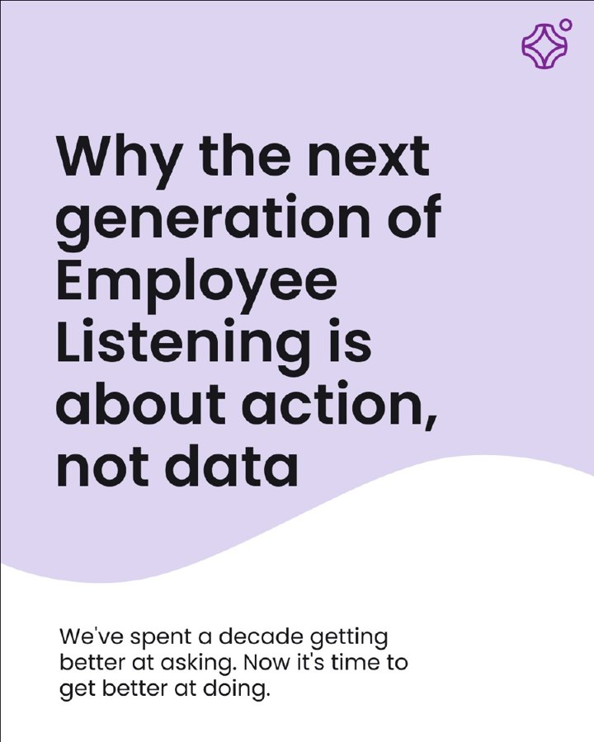
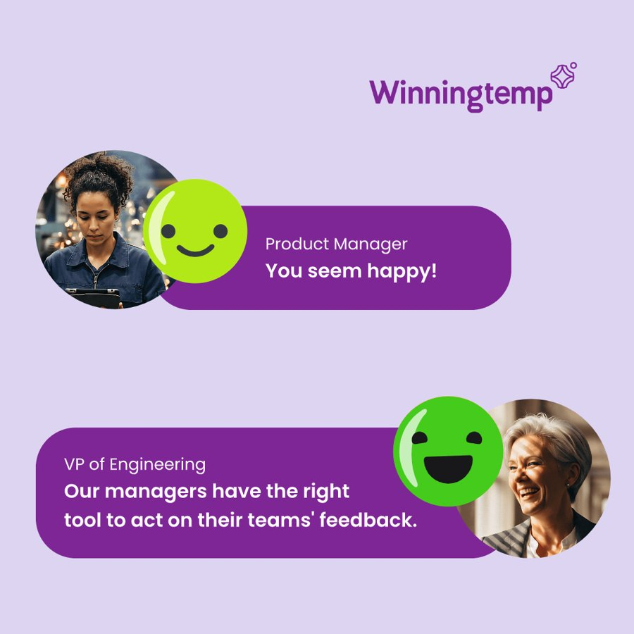
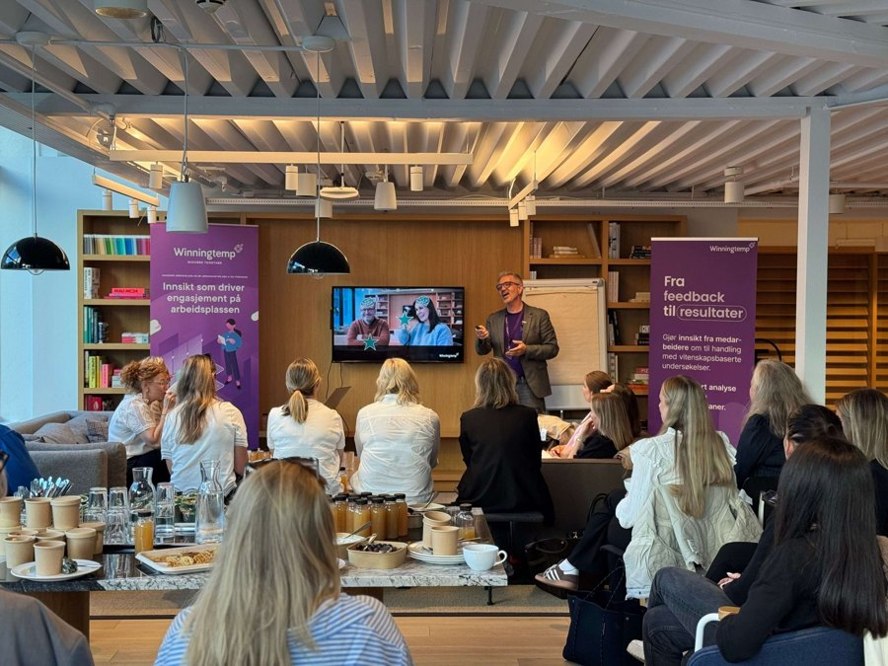
Traffic and reach creatives that worked
The video buys the cheapest clicks; the document ad buys the cheapest reach
MOFU · ROW · “Next gen listening” video
ROW · Document · “Listening is about action”
TOFU · ROW · “Next Gen Employee Listening” GIF
Boost · NO · “Gjør det du! Heia deg!” post
105 clicks · 35 SEK/click
CPM 119 SEK · 13 conv.*
CPM 141 SEK · 2 conv.
CTR 6.0% · 60 SEK/click
3 636 SEK · 32 258 impressions
CTR 0.33% · CPM 113 SEK
12 298 views · 858 completions (7%)
Cheapest clicks in the account again.
2 231 SEK · 18 760 impressions
26 clicks · CTR 0.14% · 86 SEK/click
*10 of 13 on 24 Sep from 2 clicks
(view-through, not ad-driven).
1 713 SEK · 12 153 impressions
15 clicks · CTR 0.12%
Efficient reach for the remarketing pool.
2 473 SEK · 679 impressions
41 clicks · CPM 3 642 SEK
Boosted story post: the clicks are
“see more”, not site visits.
Source: LinkedIn Marketing API via CENTCOM · 17 Sep – 4 Oct 2026 vs 30 Aug – 16 Sep (equal 18-day windows) · SEK

Slide 10
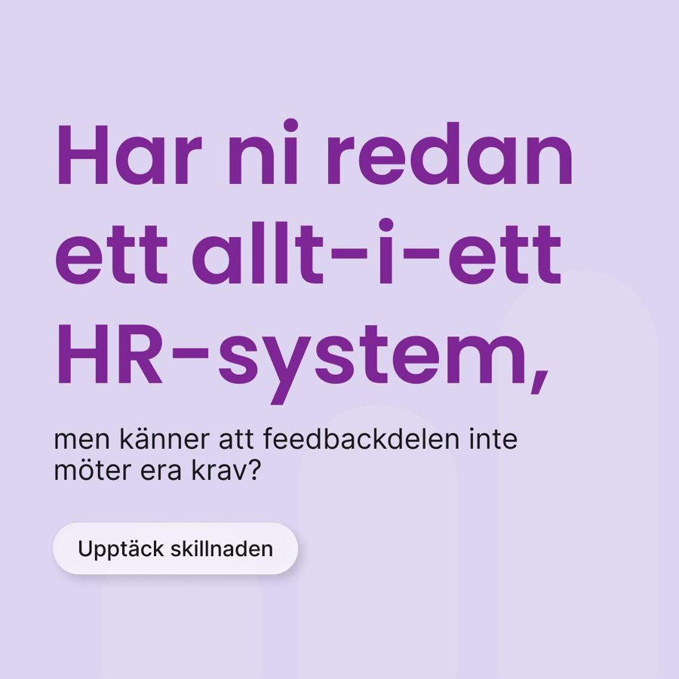
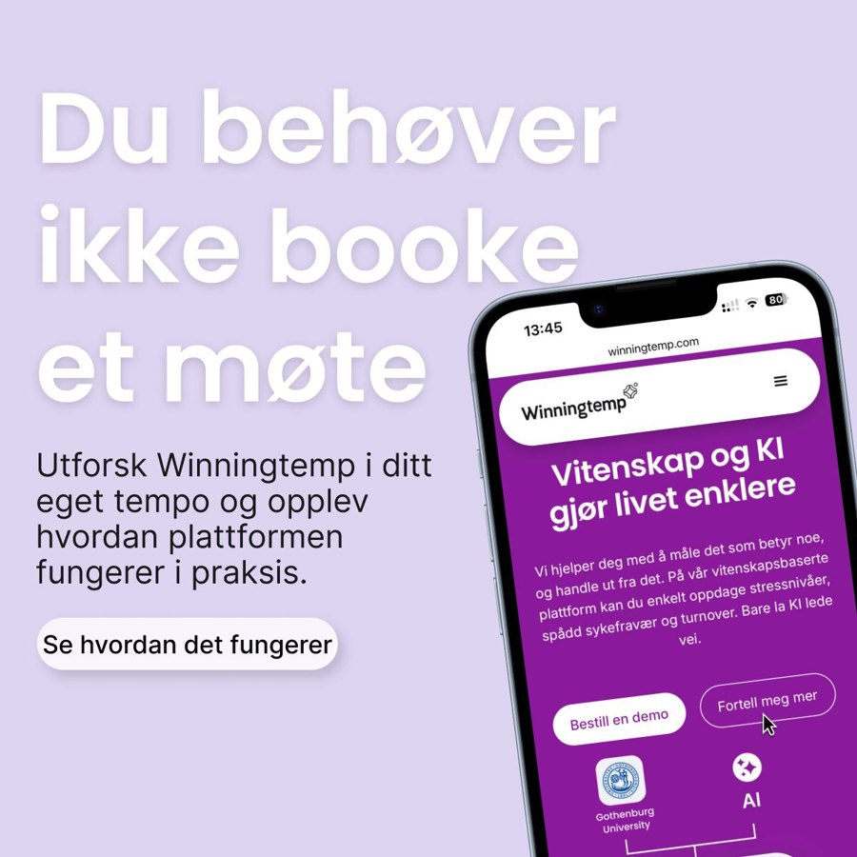

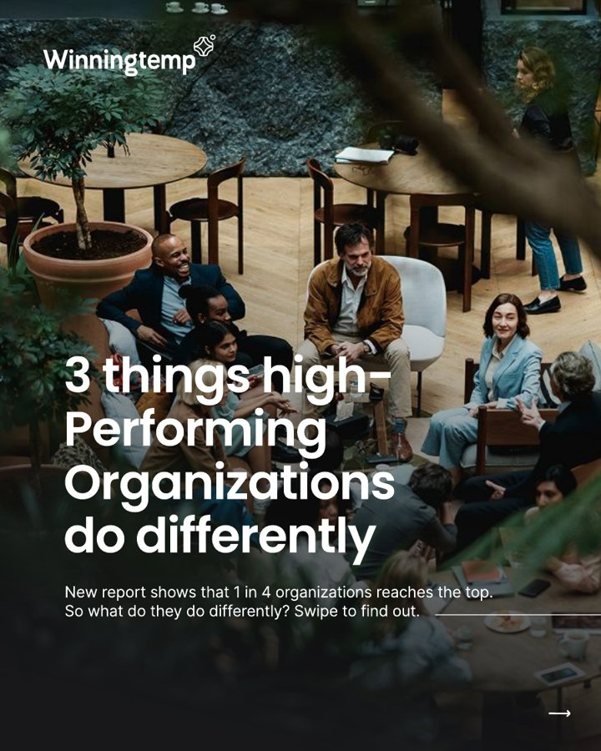
Traffic and demo creatives that did not
Two were flagged last time and still run; the 2025 form creatives have stopped converting
BOFU · SE · “Har ni redan ett allt-i-ett HR-system”
BOFU · NO · demo pair (“Du behøver ikke booke”)
MOFU · SE · WinningWay form GIFs (13 ads, 2025)
TOFU · DK · HiPO document (carousel)
1 conv. · 136 SEK/click
0 conv. · 129 SEK/click
0 sign-ups · 2 139 SEK
0 sign-ups · 724 SEK
2 178 SEK · 5 631 impressions
16 clicks · CTR 0.28% · CPM 387 SEK
Flagged 17 Sep. Still running.
1 423 SEK · 1 849 impr. (both ads)
11 clicks · CTR 0.59% · CPM 769 SEK
Flagged 17 Sep. Still running.
5 970 impr. · 34 clicks · CTR 0.57%
2 sign-ups in the previous 18 days.
Fatigue: the set is 9–12 months old.
6 295 impr. · 17 clicks · CTR 0.27%
CPM 115 SEK. Reach fine, form not.
Same as the paused ROW document ad.
Source: LinkedIn Marketing API via CENTCOM · 17 Sep – 4 Oct 2026 vs 30 Aug – 16 Sep (equal 18-day windows) · SEK

Slide 11
Format scorecard
Spend and results by creative format, all campaigns in the period
Format | Ads | Spend | Impr. | CTR | CPM | Clicks | CPC | Sign-ups | Conv. | Cost per result
Report GIF · lead gen (ROW) | 7 | 5 261 | 23 968 | 0.43% | 220 | 104 | 51 | 17 | – | 309 /sign-up
Form GIFs · lead gen (SE/NO, 2025 set) | 20 | 2 991 | 7 663 | 0.52% | 390 | 40 | 75 | – | 1 | 2 991 /conv.*
Document ads (ROW DOC, DK HiPO) | 3 | 3 467 | 31 647 | 0.15% | 110 | 49 | 71 | – | 15 | 231 /conv.*
Video (Next gen listening, NO video) | 6 | 3 859 | 33 702 | 0.32% | 114 | 109 | 35 | – | 1 | 3 859 /conv.*
Brand stills & GIFs (TOFU) | 6 | 4 455 | 31 190 | 0.12% | 143 | 36 | 124 | – | 2 | 2 228 /conv.*
Demo GIFs & stills (BOFU) | 11 | 10 491 | 16 286 | 0.36% | 644 | 58 | 181 | – | 2 | 5 246 /conv.*
Spotlight (SE/NO) | 3 | 1 683 | 44 686 | 0.05% | 38 | 23 | 73 | – | – | –
Boosted post (NO) | 2 | 2 945 | 736 | 6.25% | 4 002 | 46 | 64 | – | – | –
Only one format produces sign-ups at a price we would pay again: the report GIF in ROW, which ran on the same budget as before (5 261 vs 5 529 SEK). Video is the traffic format (35 SEK a click). Document ads are the reach format (CPM 78–119 SEK). The largest new line is the BOFU GIF set (6 890 SEK).
*Conversions include view-through matches; treat the cost per conversion as a floor, not a price.
Source: LinkedIn Marketing API via CENTCOM · 17 Sep – 4 Oct 2026 vs 30 Aug – 16 Sep (equal 18-day windows) · SEK

Slide 12
Meta since the last CPR
17 Sep – 4 Oct 2026: same budget, half the impressions, and the first lead-form sign-ups
Spend
Clicks · CTR
Lead-form sign-ups
Cost per sign-up (lead ads)
11 606 SEK
938 · 0.18%
33
75 SEK
10 351 SEK in 1–16 Sep
664 · 0.09% previous
0 previous · live since 25 Sep
LinkedIn: 528 SEK same period
Weekly spend, SEK
Lead-form sign-ups per week
Impressions per week (thousands)
Weekly spend flat at 4–5k SEK through both periods. What changed is the mix: reach videos at CPM 14 SEK gave way to lead ads at CPM ~165 SEK, so impressions halved while sign-ups went from 0 to 16 and 17 in the last two weeks. Lead quality not yet verified in HubSpot.
■ before the 17 Sep CPR ■ since the CPR
* 27 Aug week = 1–2 Sep only (export start) · 1 Oct week = 1–4 Oct
Source: Meta Ads Manager export (day × ad), 1 Sep – 5 Oct 2026 · 17 Sep – 4 Oct 2026 vs 1–16 Sep (export starts 1 Sep) · SEK

Slide 13
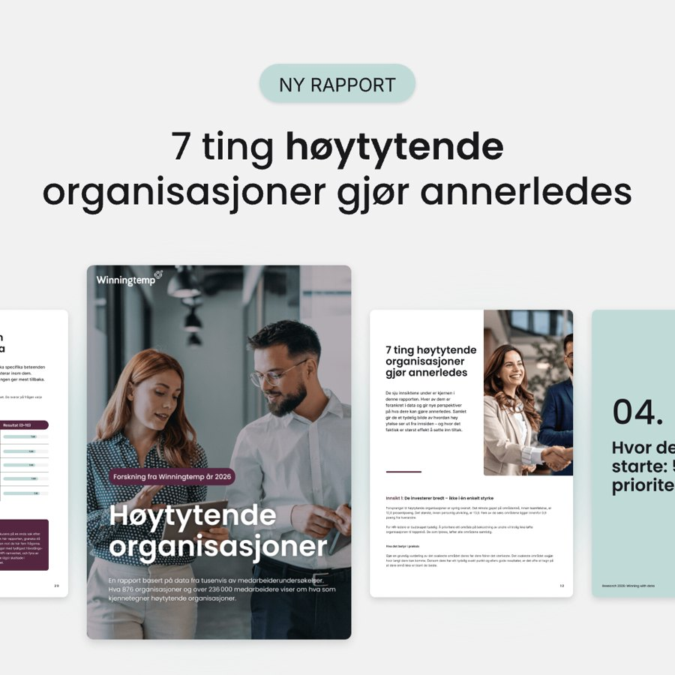
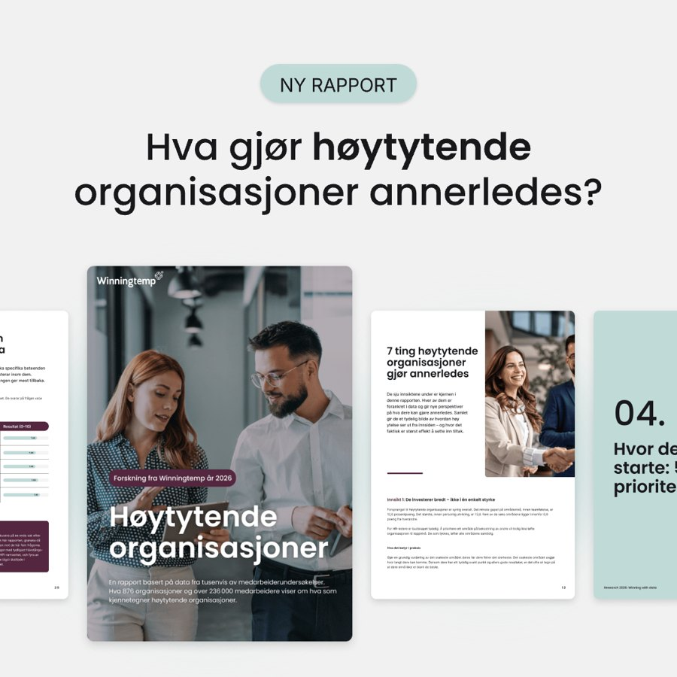
Meta creatives that worked
Two NO report ads carry all 33 sign-ups; the Sommergraf ad buys link clicks for 4 SEK
Image not in export
Sommergraf C · NO · link-click ad
Guide HIPO C · NO · “7 innsikter ledere…”
Guide HIPO A · NO · “Hva gjør høytytende…”
Sommergraf C · NO · link-click ad
“Next Gen Employee Listening” video · SE+NO
19 sign-ups · 92 SEK each
14 sign-ups · 43 SEK each
115 link clicks · 4 SEK each
CPM 17 SEK · 329k reach
1 757 SEK · 10 589 impressions
193 clicks · CTR 1.82% · CPM 166 SEK
Live since 25 Sep. 19 of 33 sign-ups.
597 SEK · 3 542 impressions
69 clicks · CTR 1.95% · CPM 169 SEK
Cheapest sign-up on any channel this period.
458 SEK · 3 653 impressions
CTR 3.20% · CPM 125 SEK
Live since 28 Sep. Where do the clicks land?
5 606 SEK · 333 574 impressions
297 clicks · CTR 0.09%
Half of Meta spend. Reach objective, so no results counted.
Creative previews are the LinkedIn versions of the same batch (Meta export has no images) · Source: Meta Ads Manager export (day × ad), 1 Sep – 5 Oct 2026 · 17 Sep – 4 Oct 2026 vs 1–16 Sep (export starts 1 Sep) · SEK

Slide 14
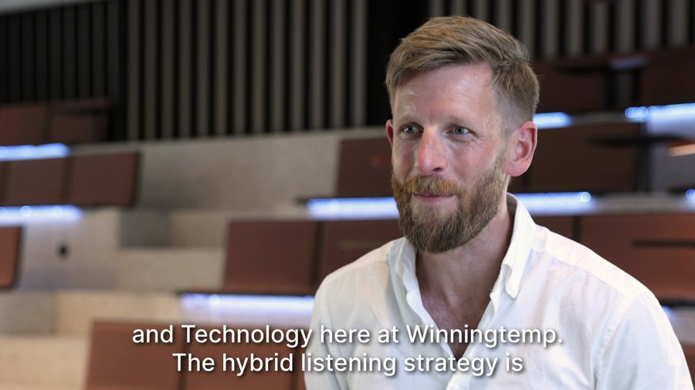
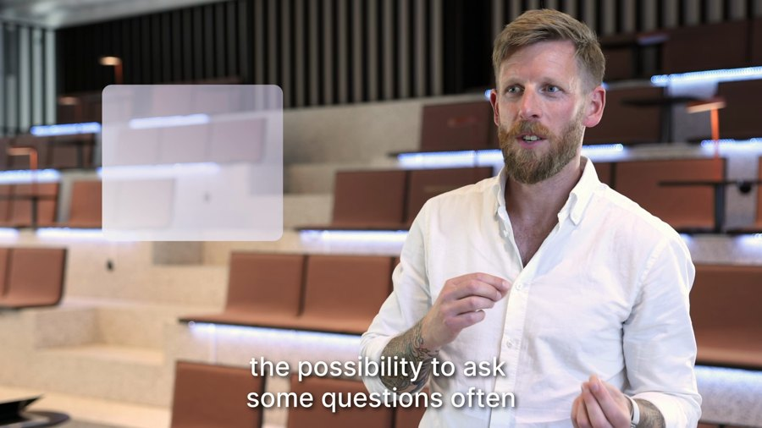
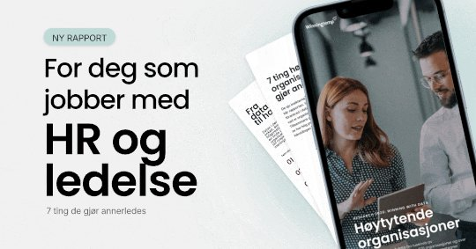
Meta creatives that did not (yet)
The reach videos buy impressions but nothing measurable; three report variants were starved, as on LinkedIn
Cost per sign-up
75 SEK
Meta · NO report lead ads
268 SEK
16:9 “Hybrid Employee Listening” · SE+NO
4:5 “Hybrid Listening” explainer · SE+NO
Guide HIPO | B, D, E · NO · three sister variants
LinkedIn · ROW report GIF
0 results · CPM 16 SEK
0 results · CPM 16 SEK
0 sign-ups · 115 SEK total
Same report, same promise. 100% of Meta sign-ups are NO; 24 of 33 are women 35–64. Check the 33 contacts in HubSpot before scaling.
2 488 SEK · 157 040 impressions
165 clicks · CTR 0.11%
Spend halved vs 1–16 Sep (5 062 SEK). Reach only.
346 SEK · 22 266 impressions
19 clicks · CTR 0.09%
Portrait cut of the same video. Small budget.
678 impressions · 5 clicks
B 42 · D 36 · E 37 SEK. Auto-rotation moved
the budget to C and A within a day.
Same starvation as on LinkedIn.
Creative previews are the LinkedIn versions of the same batch (Meta export has no images) · Source: Meta Ads Manager export (day × ad), 1 Sep – 5 Oct 2026 · 17 Sep – 4 Oct 2026 vs 1–16 Sep (export starts 1 Sep) · SEK

Slide 15
What we do next
Proposed actions for the coming four weeks
Give the winner a successor Build three square variants on the “7 things” structure (new cover angle, a stat-led version, a Swedish version) and test them in a separate ROW campaign with even rotation — 1 500 SEK each — instead of inside the current campaign.
Set a fatigue rule Rotate the winner out when cost per sign-up is above 350 SEK for two consecutive weeks. Today: ~300 SEK and rising.
Give the G2-quote GIFs a fair test Keep the SE portrait and NO versions, widen the audiences until CPM is under 400 SEK, add UTM tags, and judge on cost per landing-page click (target under 150 SEK) and HubSpot demos after 300 clicks.
Keep video + document as the traffic engine Cap the NO Boost at 1 000 SEK and only boost posts with organic traction. Judge every creative on clicks and sign-ups, not on view-through conversions.
Meta: verify, then scale Check the 33 NO sign-ups in HubSpot (job titles, companies). If they hold up, double Guide HIPO C and A, launch an SE copy, and move half the reach-video budget there.

Slide 16
Questions?

